Slide 1
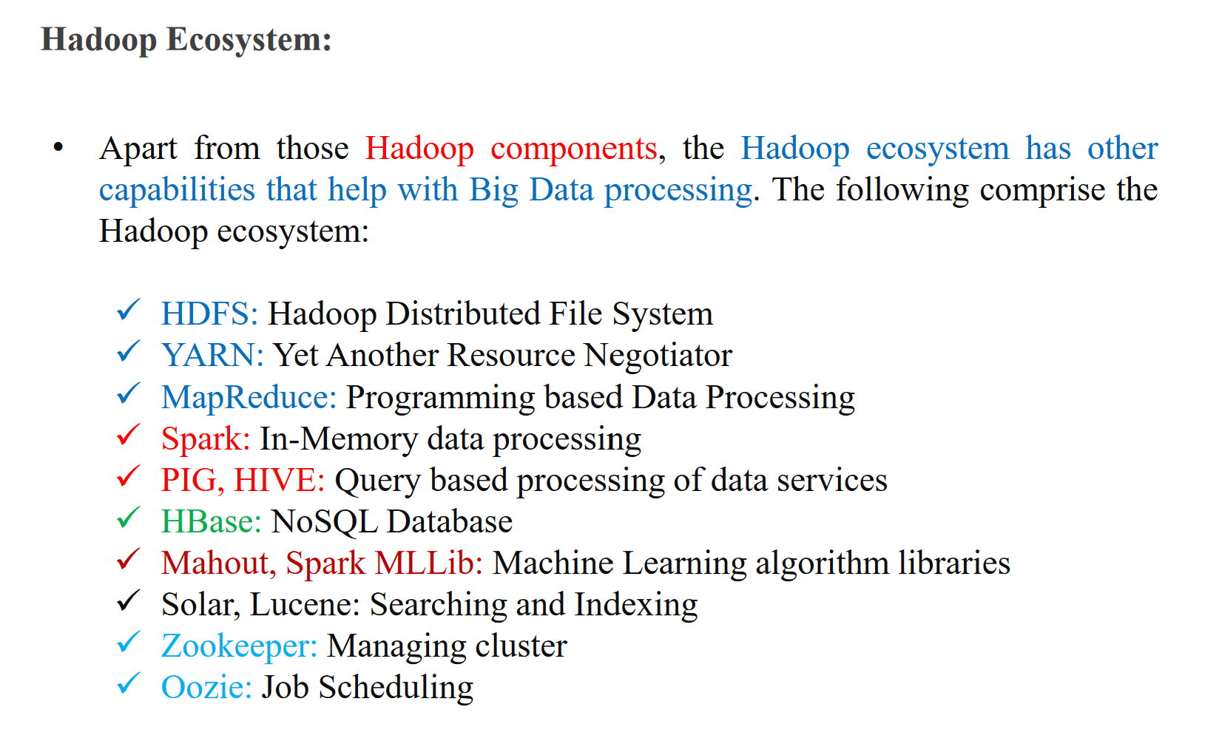

Slide 2
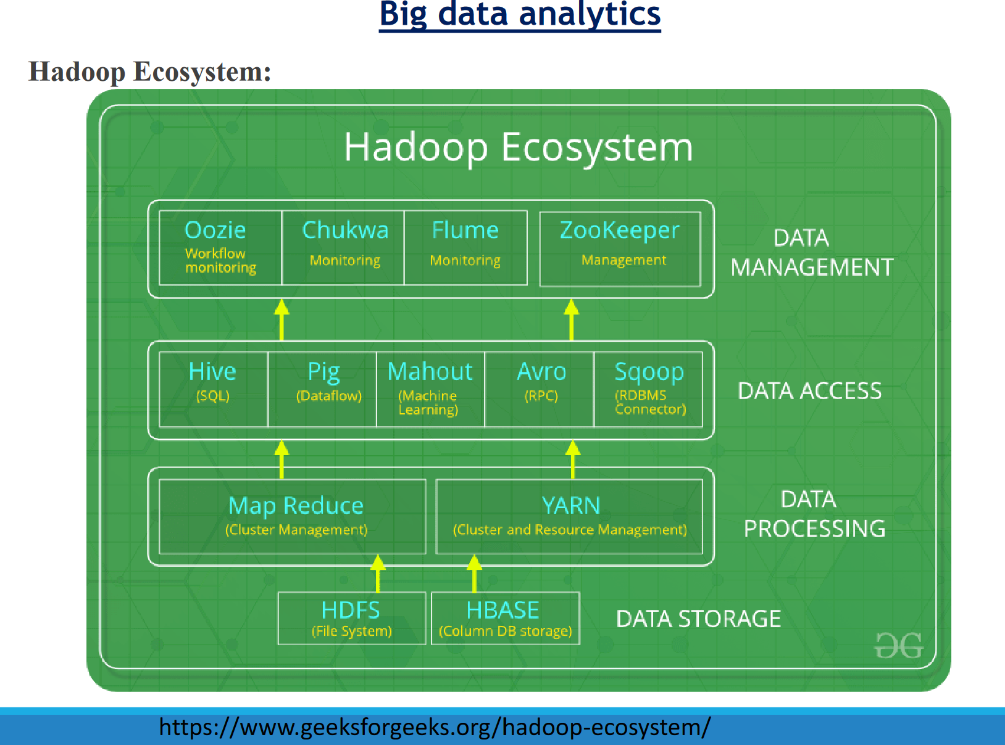

Slide 3
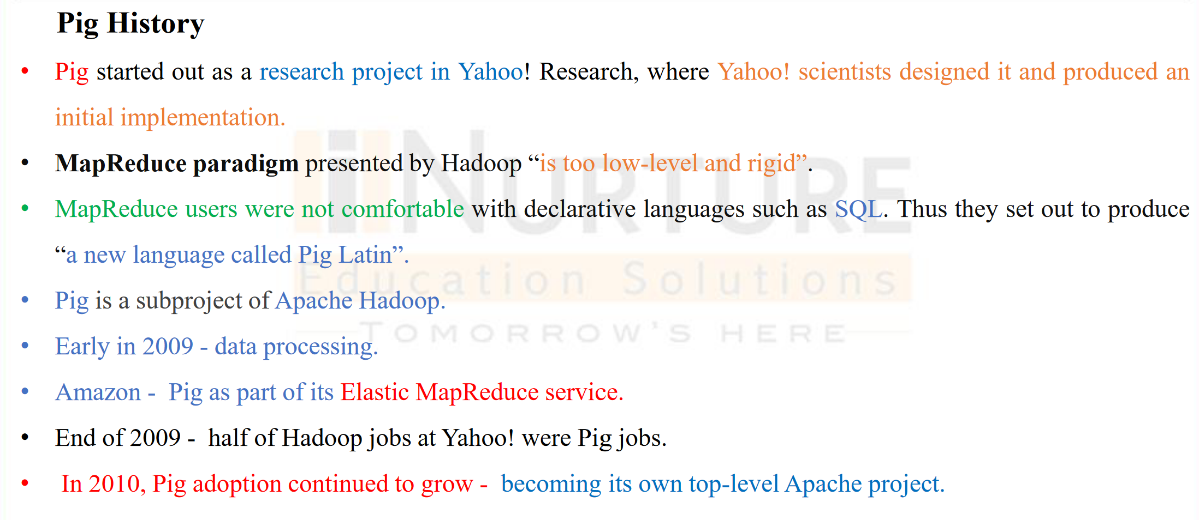

Slide 4
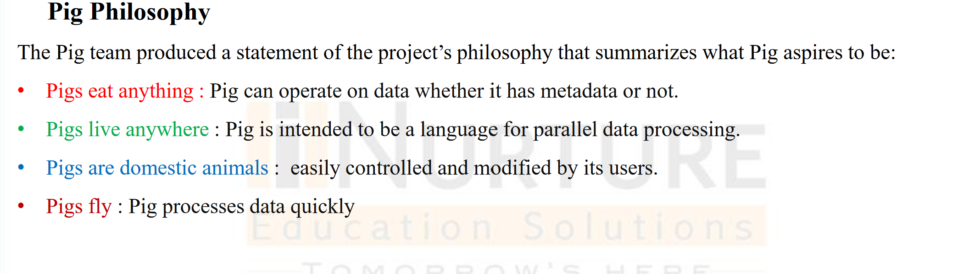

Slide 5
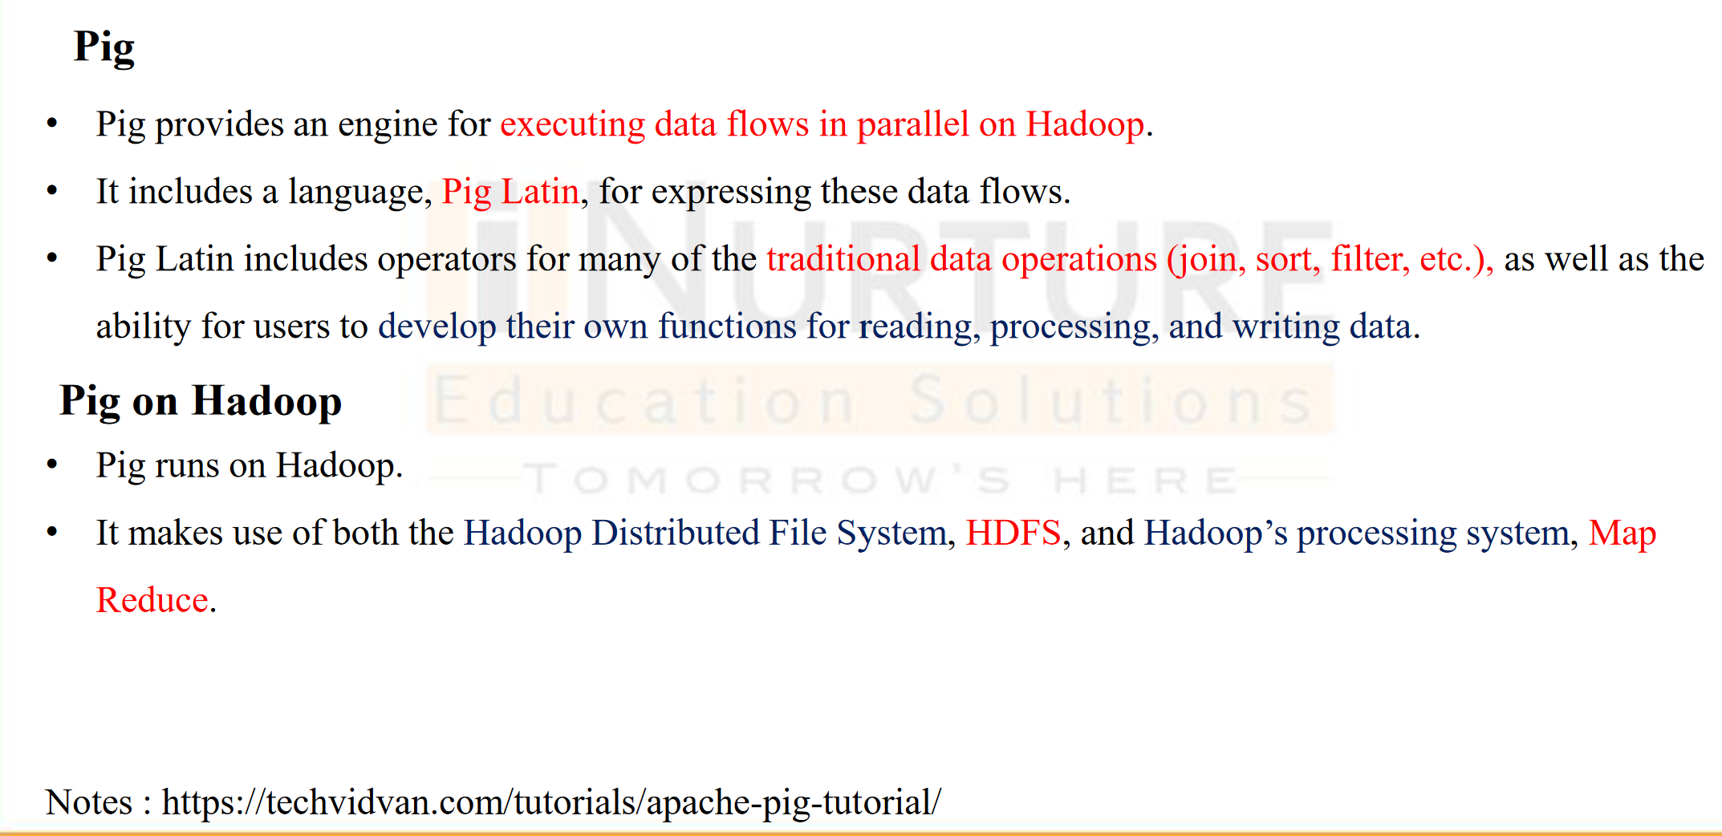
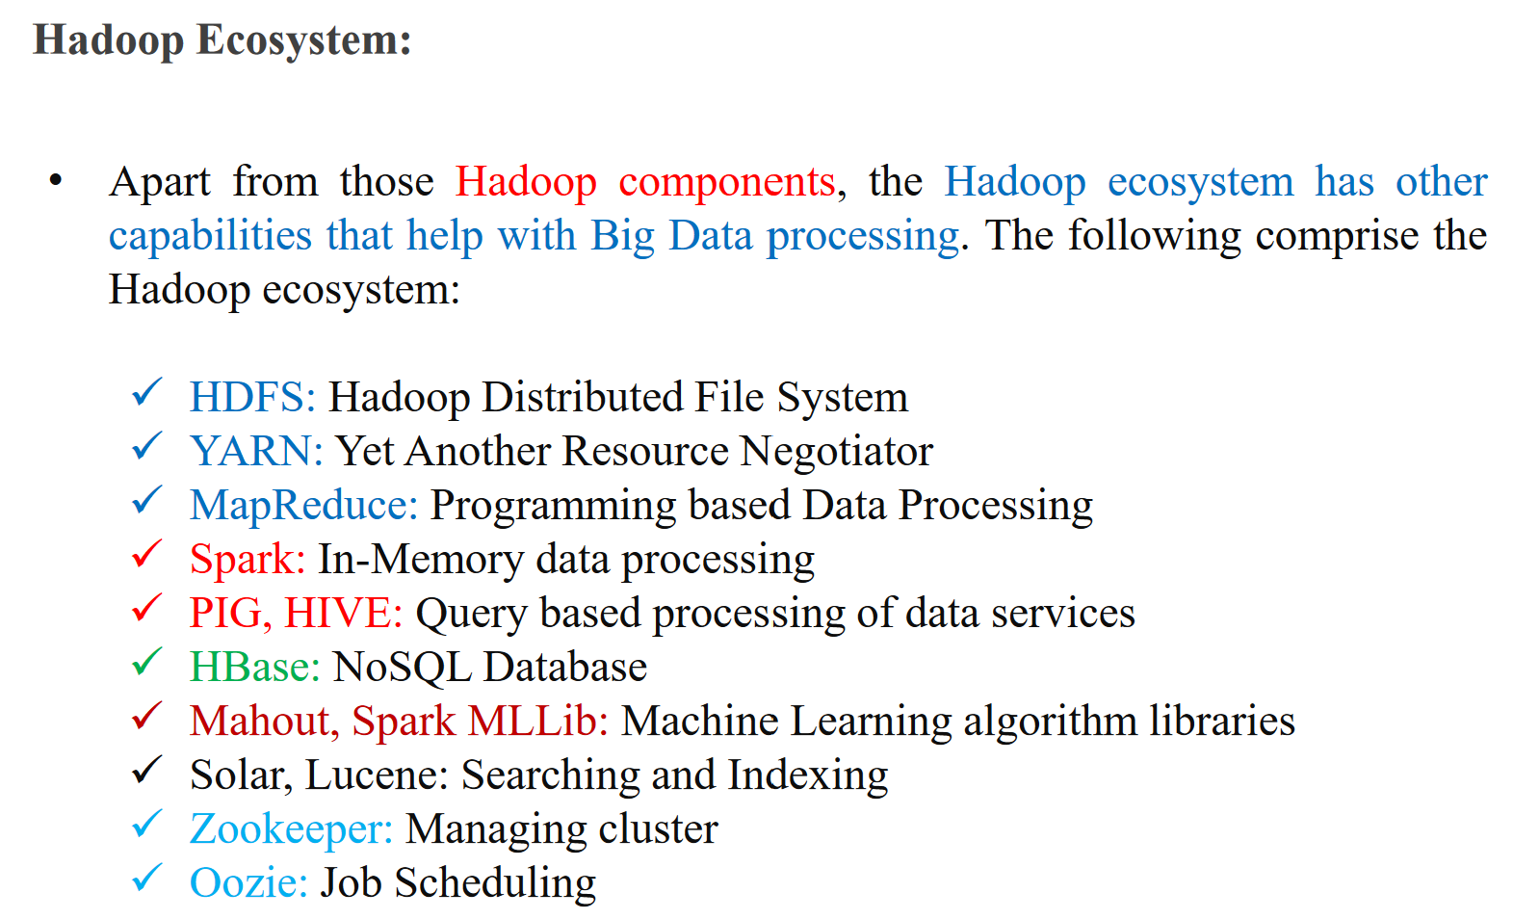

Slide 6
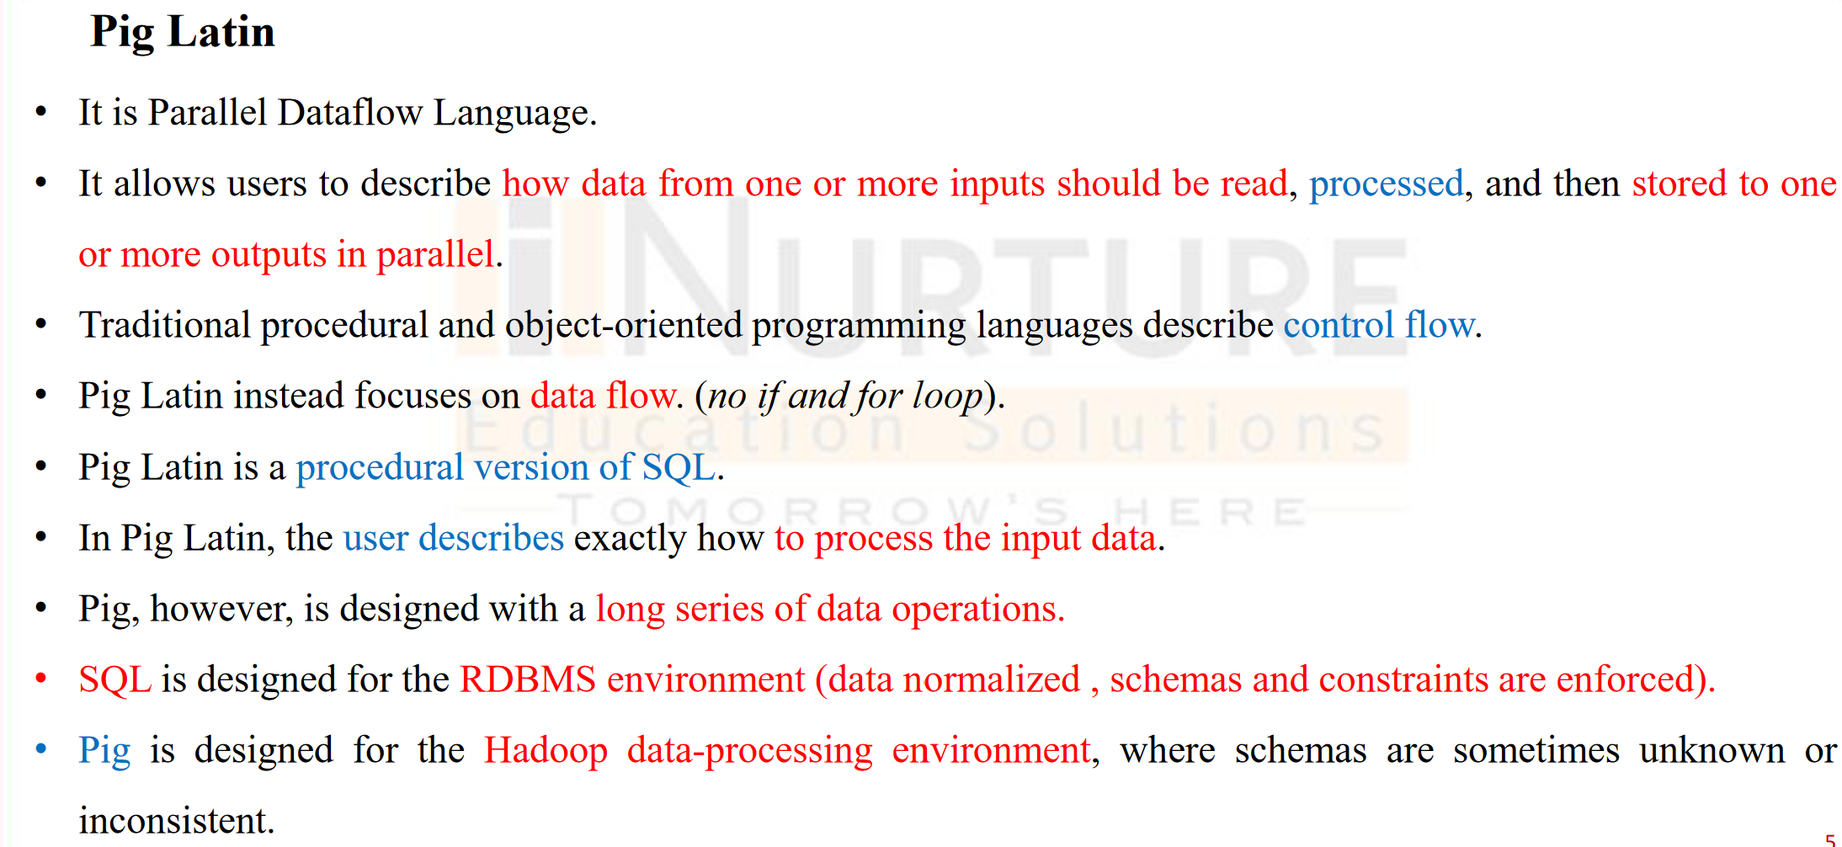

Slide 7
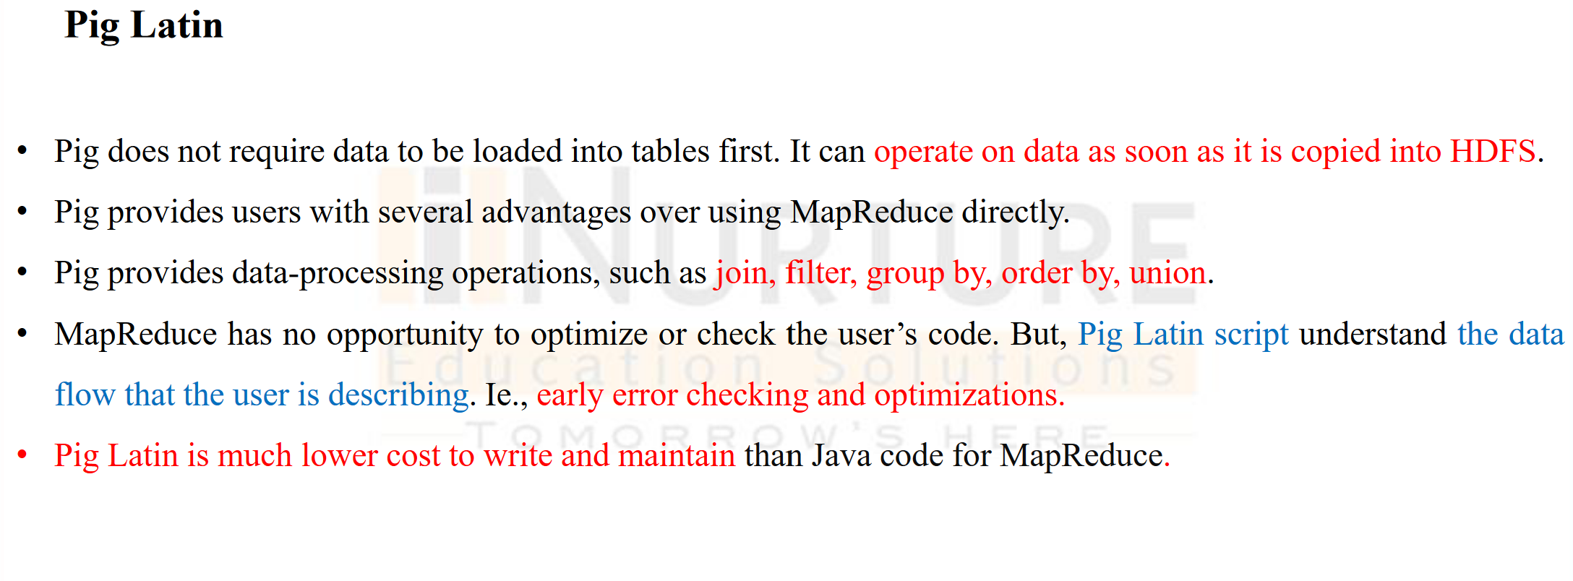

Slide 8
Apache Pig Execution Modes
You can run Apache Pig in two modes, namely, Local Mode and HDFS mode.
Local Mode
In this mode, all the files are installed and run from your local host and local file system. There is no need of Hadoop or HDFS. This mode is generally used for testing purpose.
MapReduce Mode
MapReduce mode is where we load or process the data that exists in the Hadoop File System (HDFS) using Apache Pig. In this mode, whenever we execute the Pig Latin statements to process the data, a MapReduce job is invoked in the back-end to perform a particular operation on the data that exists in the HDFS.

Slide 9
Apache Pig Execution Mechanisms
Apache Pig scripts can be executed in three ways, namely, interactive mode, batch mode, and embedded mode.
Interactive Mode (Grunt shell) − You can run Apache Pig in interactive mode using the Grunt shell. In this shell, you can enter the Pig Latin statements and get the output (using Dump operator).
Batch Mode (Script) − You can run Apache Pig in Batch mode by writing the Pig Latin script in a single file with .pig extension.
Embedded Mode (UDF) − Apache Pig provides the provision of defining our own functions (User Defined Functions) in programming languages such as Java, and using them in our script.

Slide 10
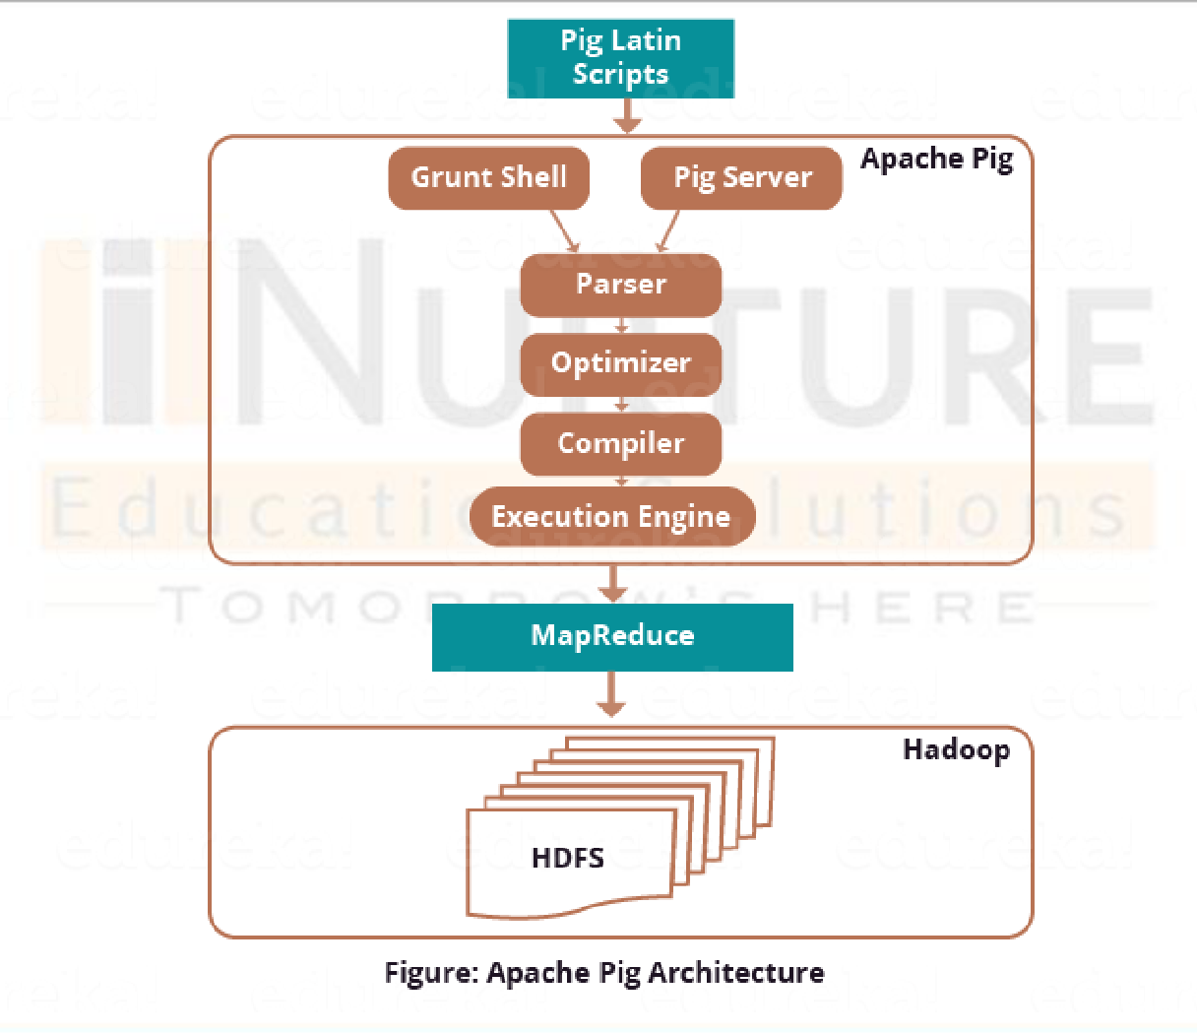
Architecture of Hadoop

Slide 11
Difference between MapReduce and Pig
MapReduce is a model that works over Hadoop to access big data efficiently stored in HDFS (Hadoop Distributed File System). It is the core component of Hadoop, which divides the big data into small chunks and process them parallelly.
Features of MapReduce:
It can store and distribute huge data across various servers.
Allows users to store data in a map and reduce form to get processed.
It protects the system to get any unauthorized access.
It supports the parallel processing model.

Slide 12
Difference between MapReduce and Pig
Pig is an open-source tool that is built on the Hadoop ecosystem for providing better processing of Big data. It is a high-level scripting language that is commonly known as Pig Latin scripts. It works on the HDFS (Hadoop Distributed File System), which supports the use of various types of data.
Features of Pig:
It allows the user to create custom user-defined functions.
It is extensible to use.
Supports a variety of data types such as char, long, float, schema, and functions.
Provides different operations on HDFS such as GROUP, FILTER, JOIN, SORT.

Slide 13
Difference between MapReduce and Pig
S.No | MapReduce | Pig
1. | It is a Data Processing Language. | It is a Data Flow Language.
2. | It converts the job into map-reduce functions. | It converts the query into map-reduce functions.
3. | It is a Low-level Language. | It is a High-level Language
4. | It is difficult for the user to perform join operations. | Makes it easy for the user to perform Join operations.
5. | The user has to write 10 times more lines of code to perform a similar task than Pig. | The user has to write fewer lines of code because it supports the multi-query approach.
6. | It has several jobs therefore execution time is more. | It is less compilation time as the Pig operator converts it into MapReduce jobs.

Slide 14
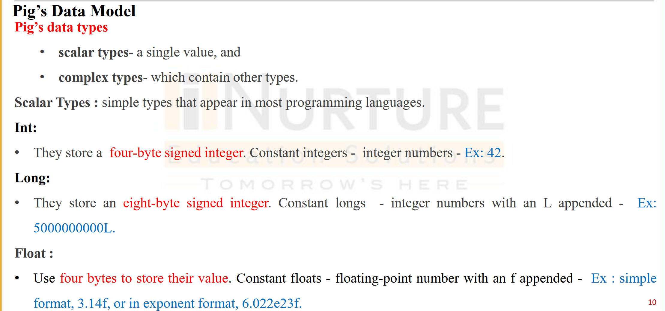
Scalar Data Types

Slide 15
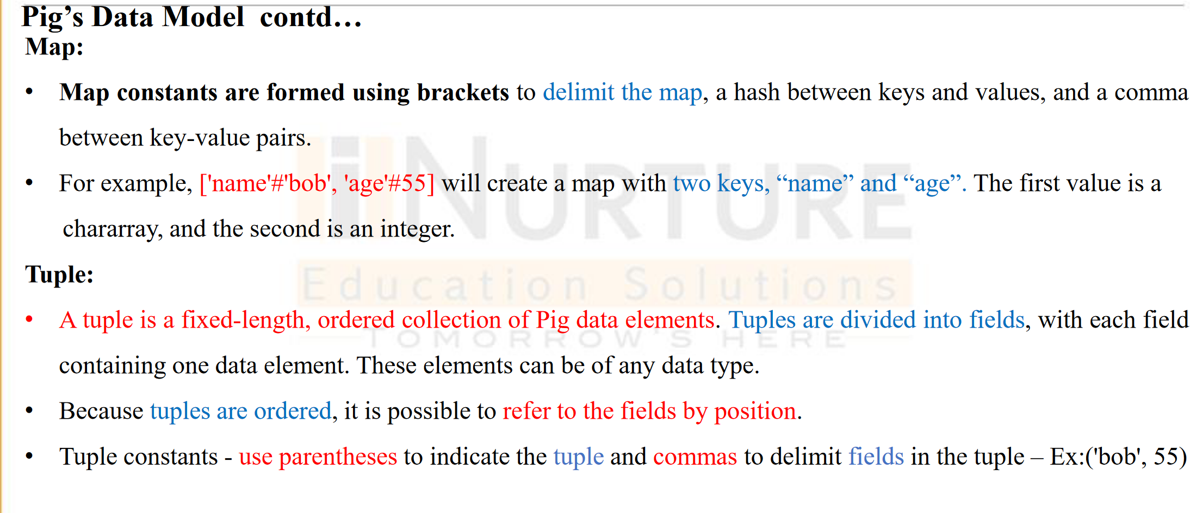
Pig – Complex Data types

Slide 16
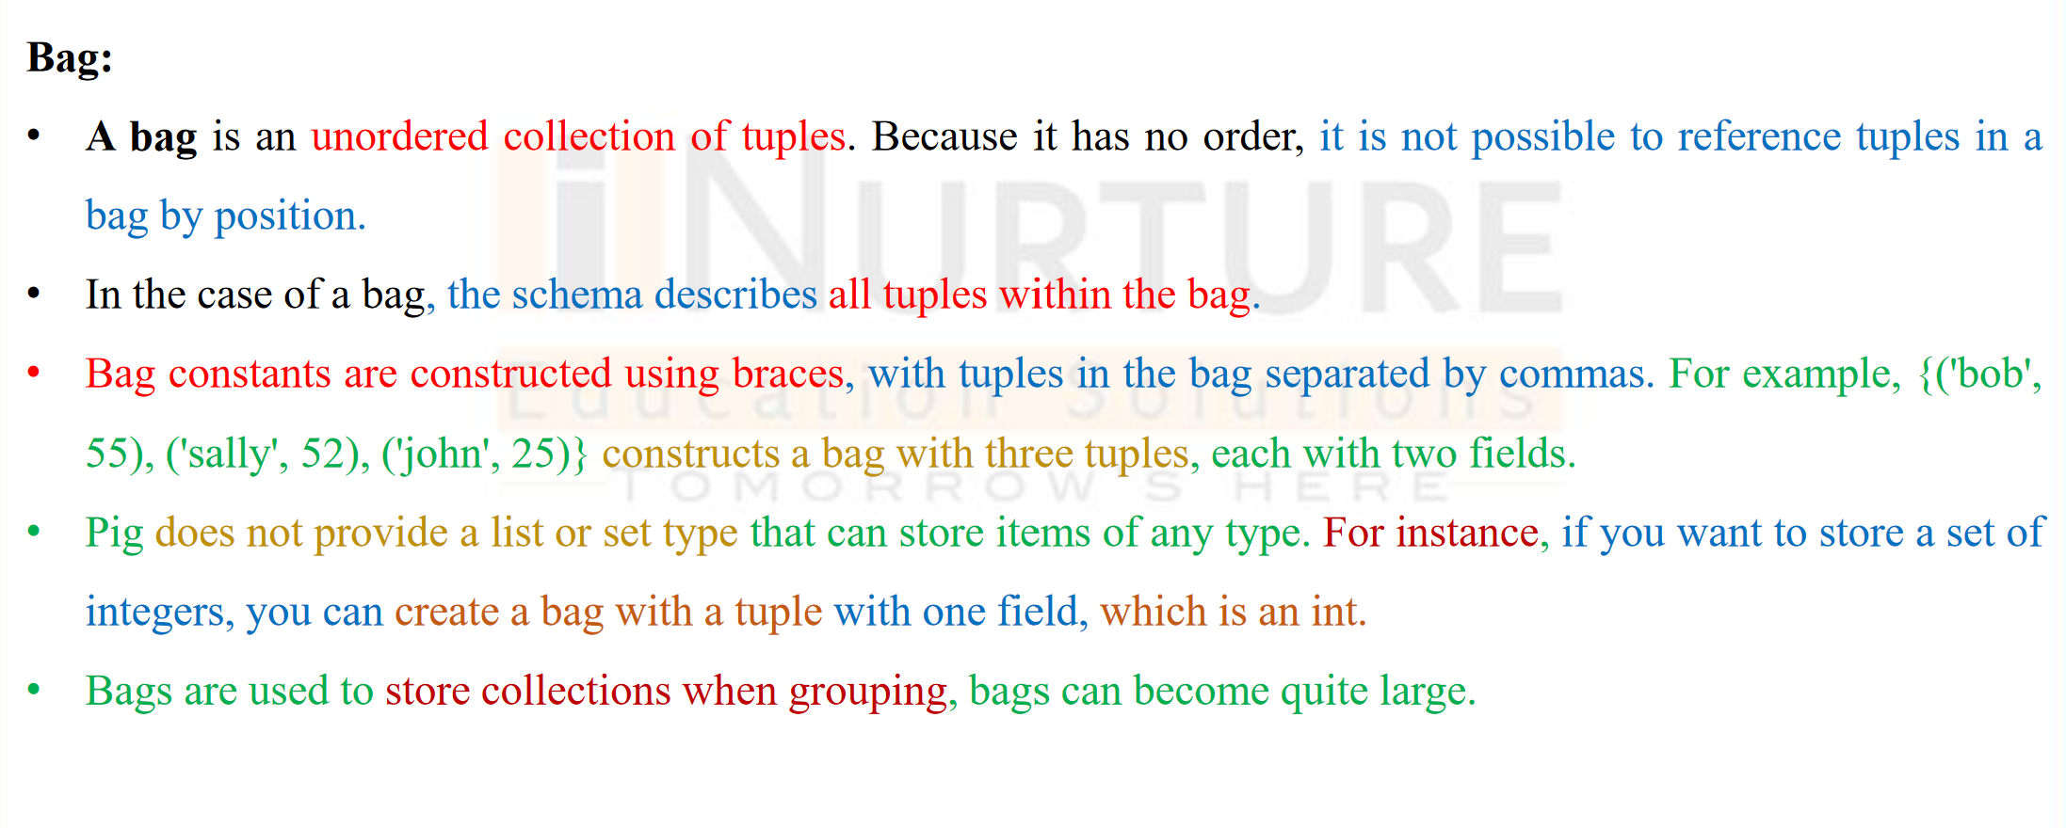
Pig – Complex Data types

Slide 17
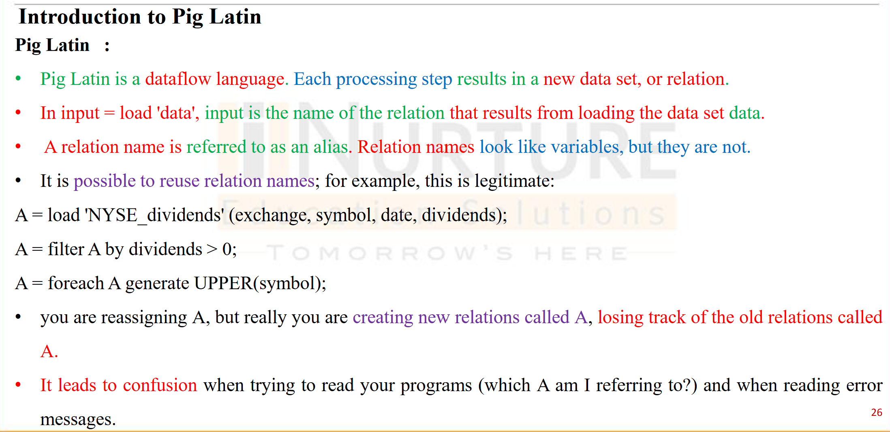

Slide 18
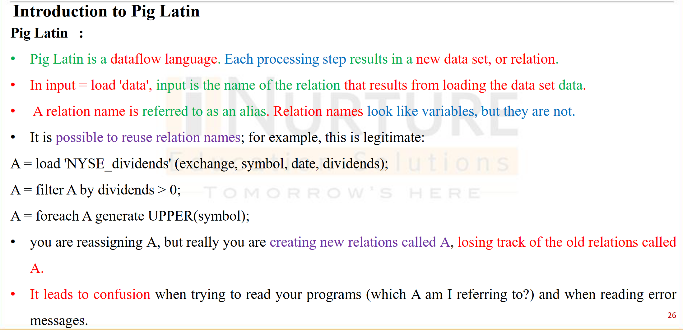
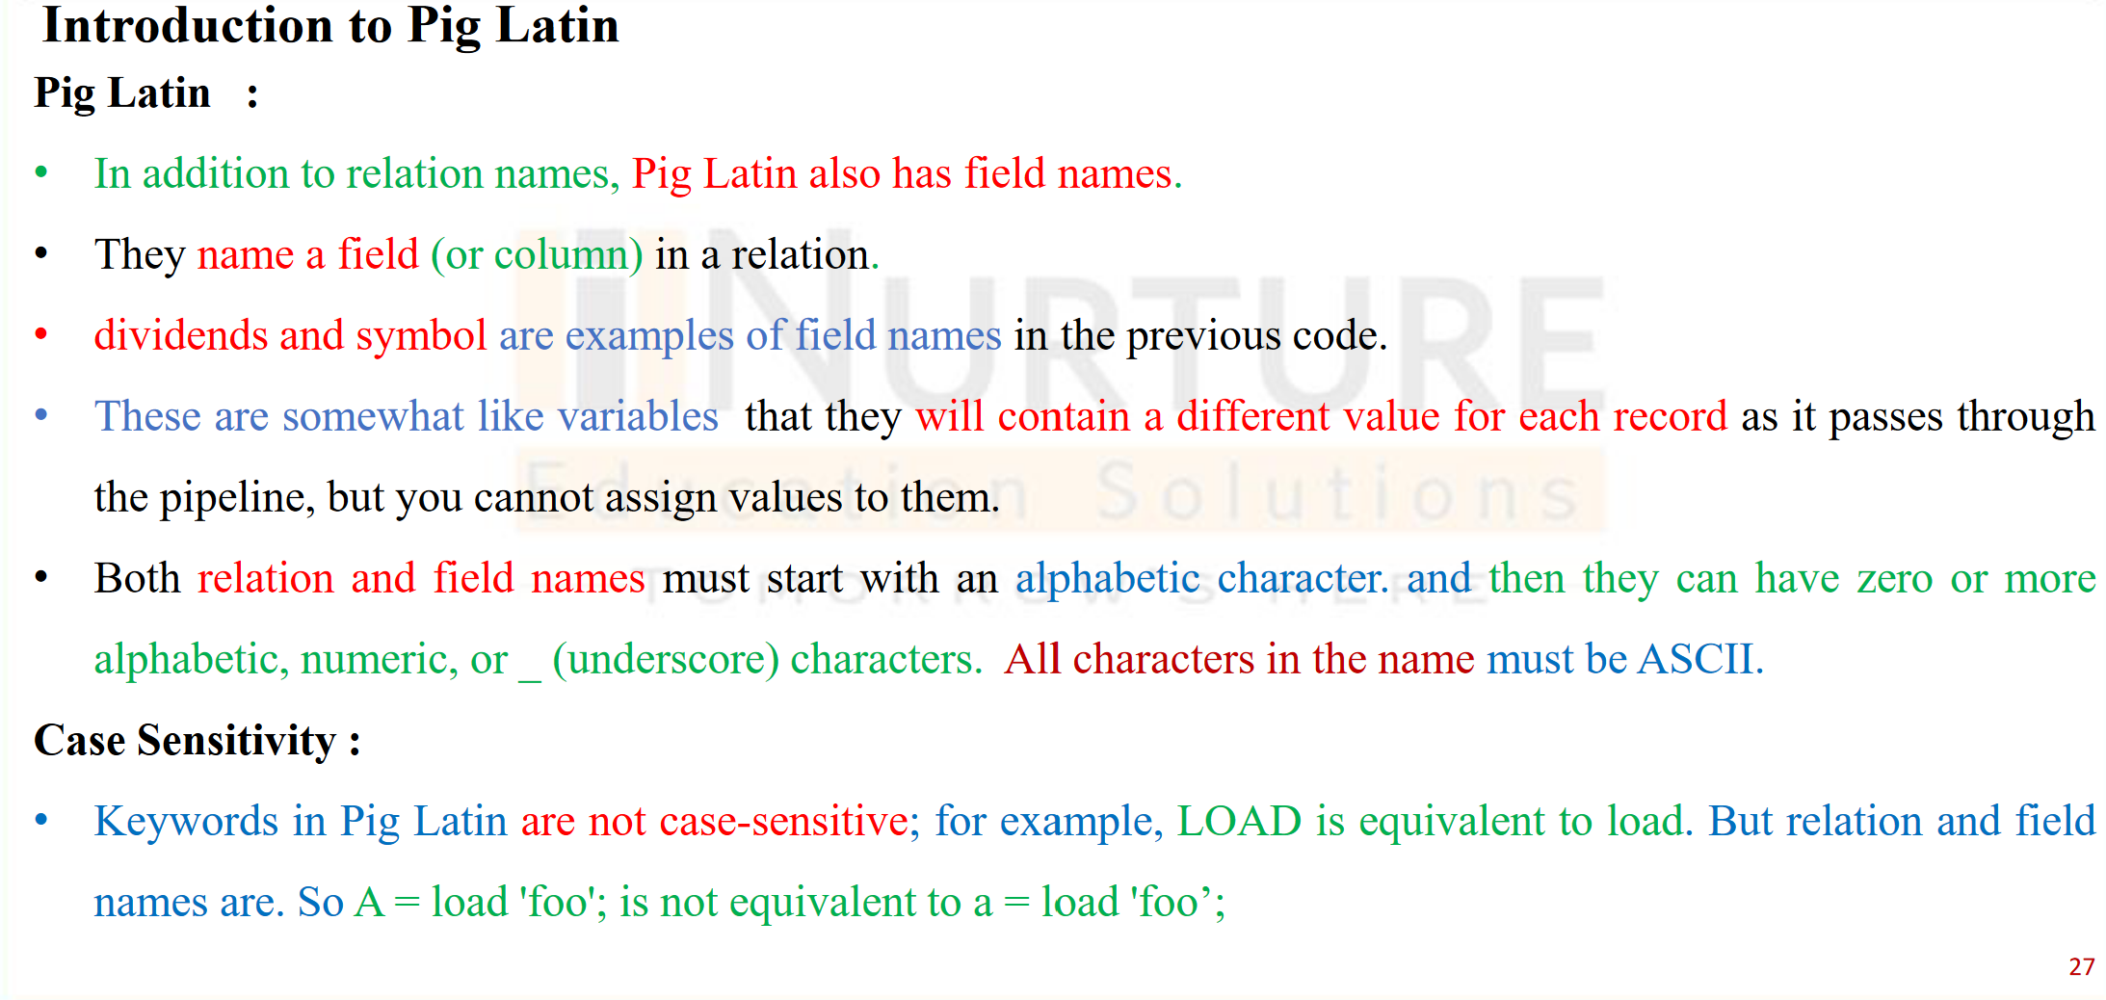

Slide 19
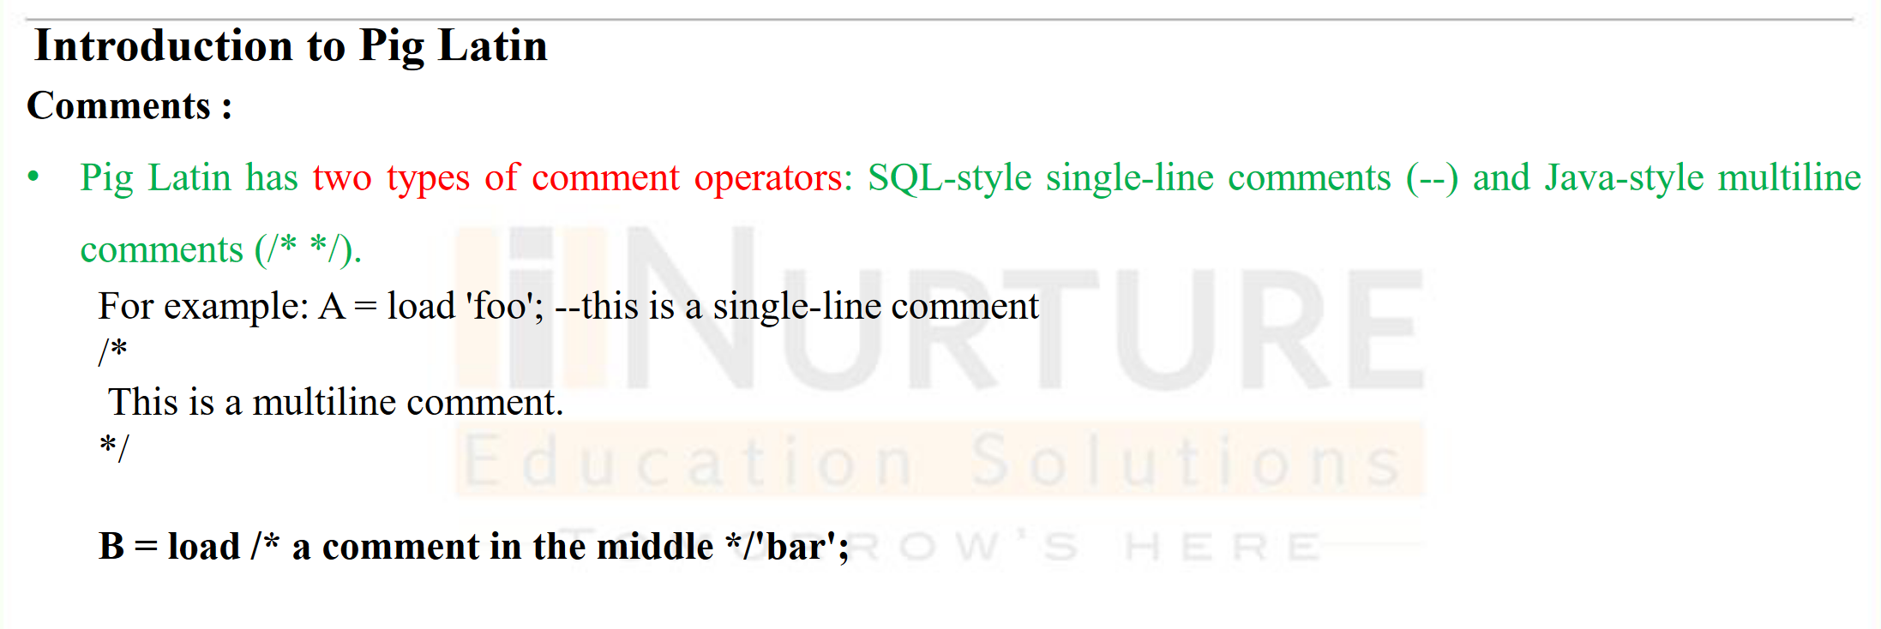

Slide 20
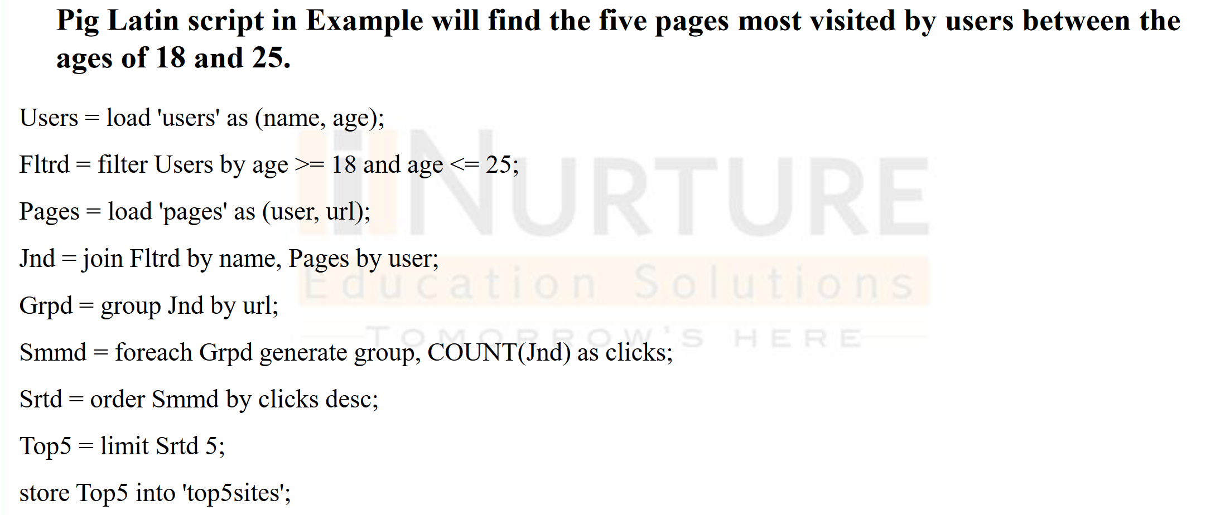

Slide 21
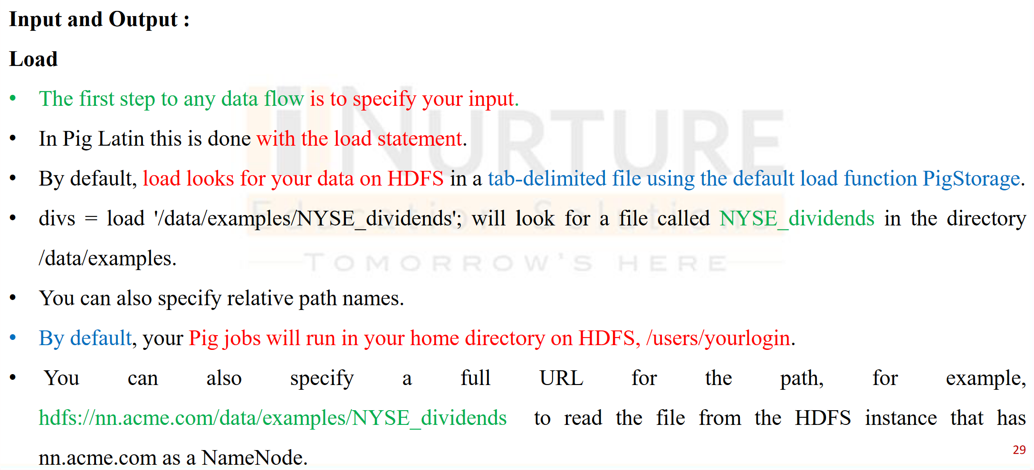

Slide 22
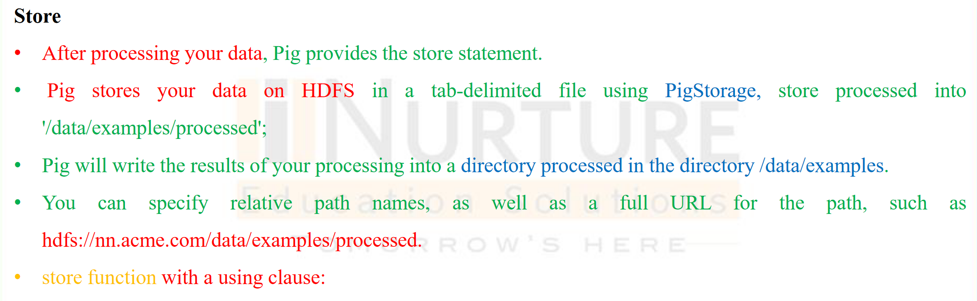

Slide 23
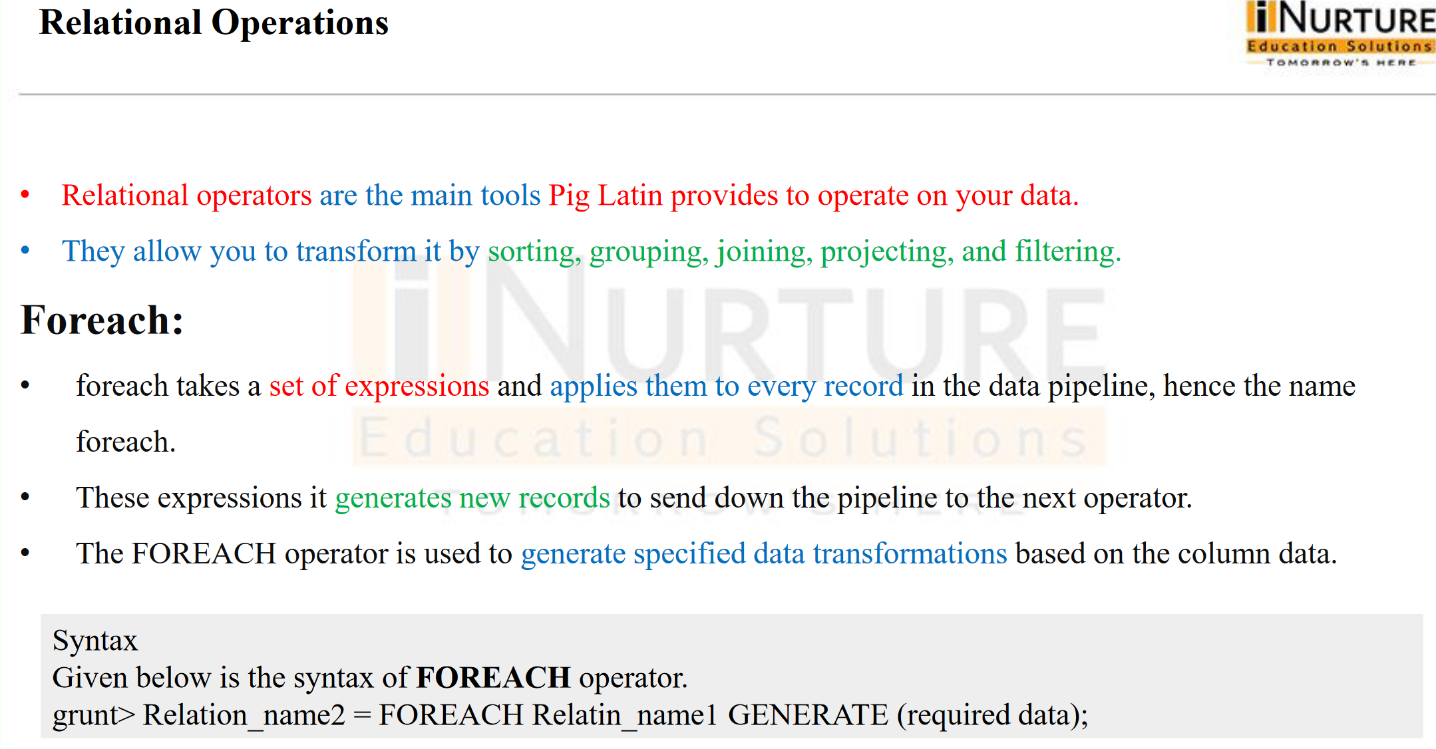

Slide 24
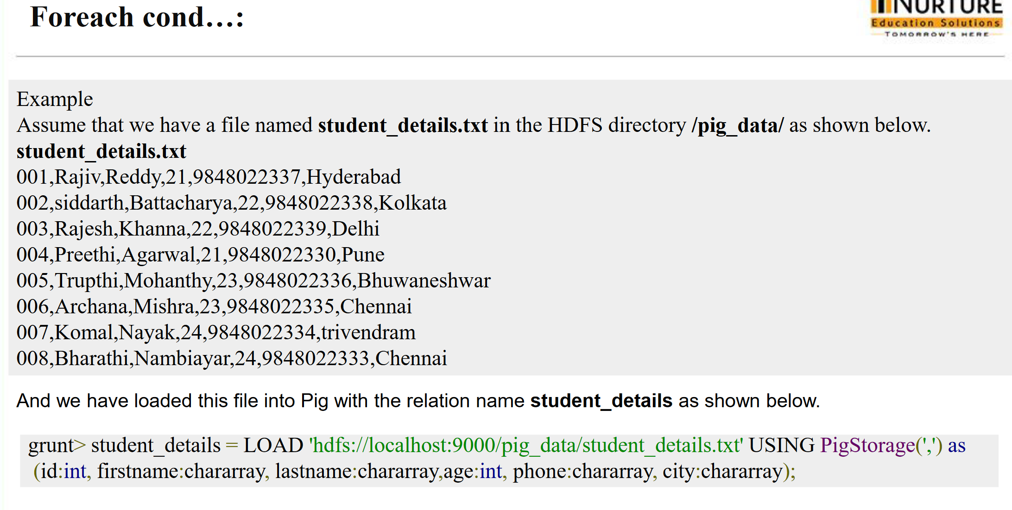

Slide 25
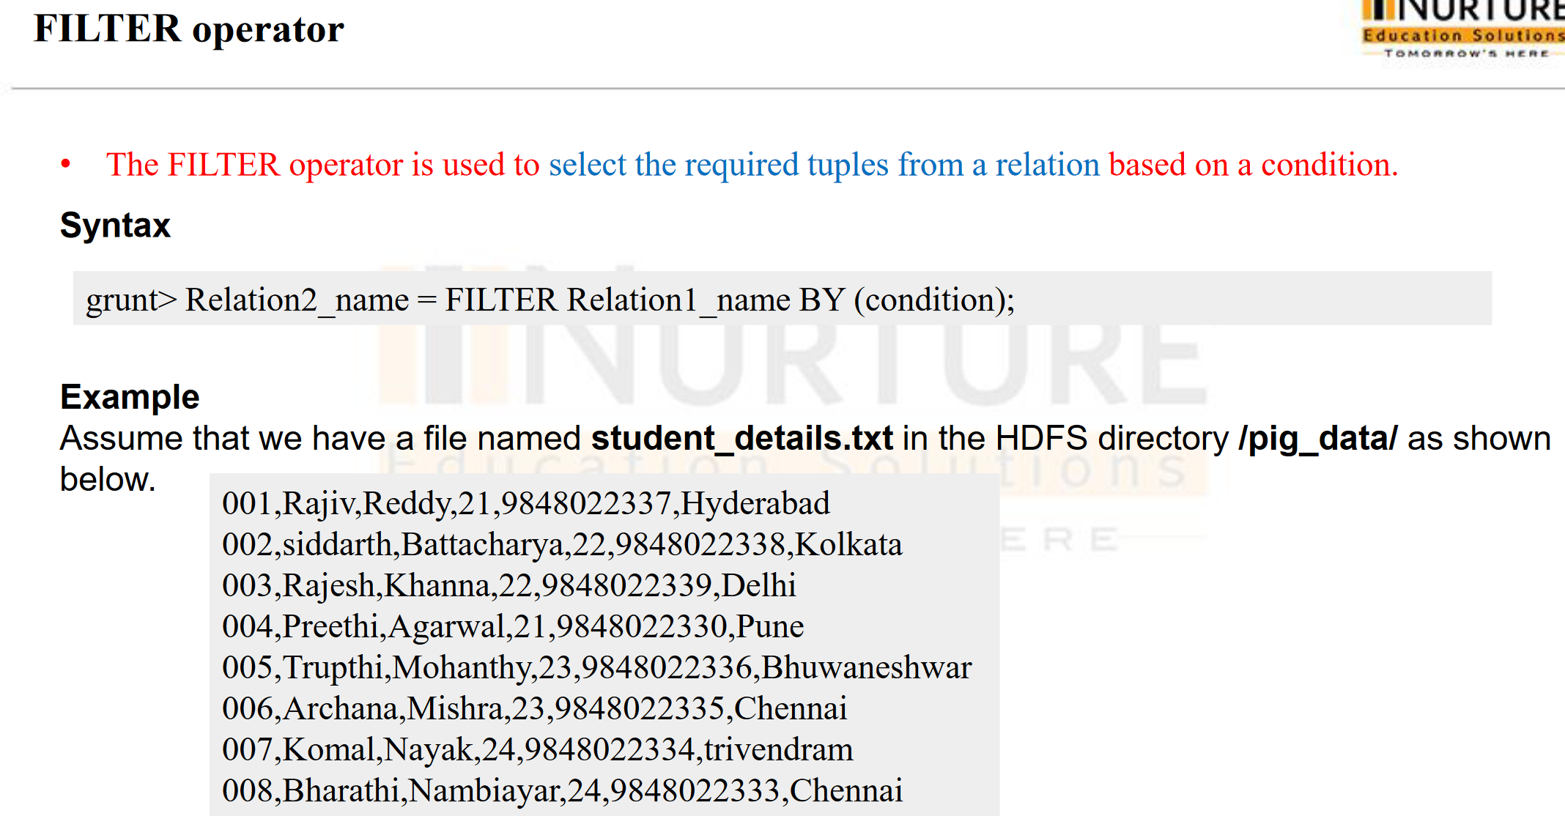

Slide 26
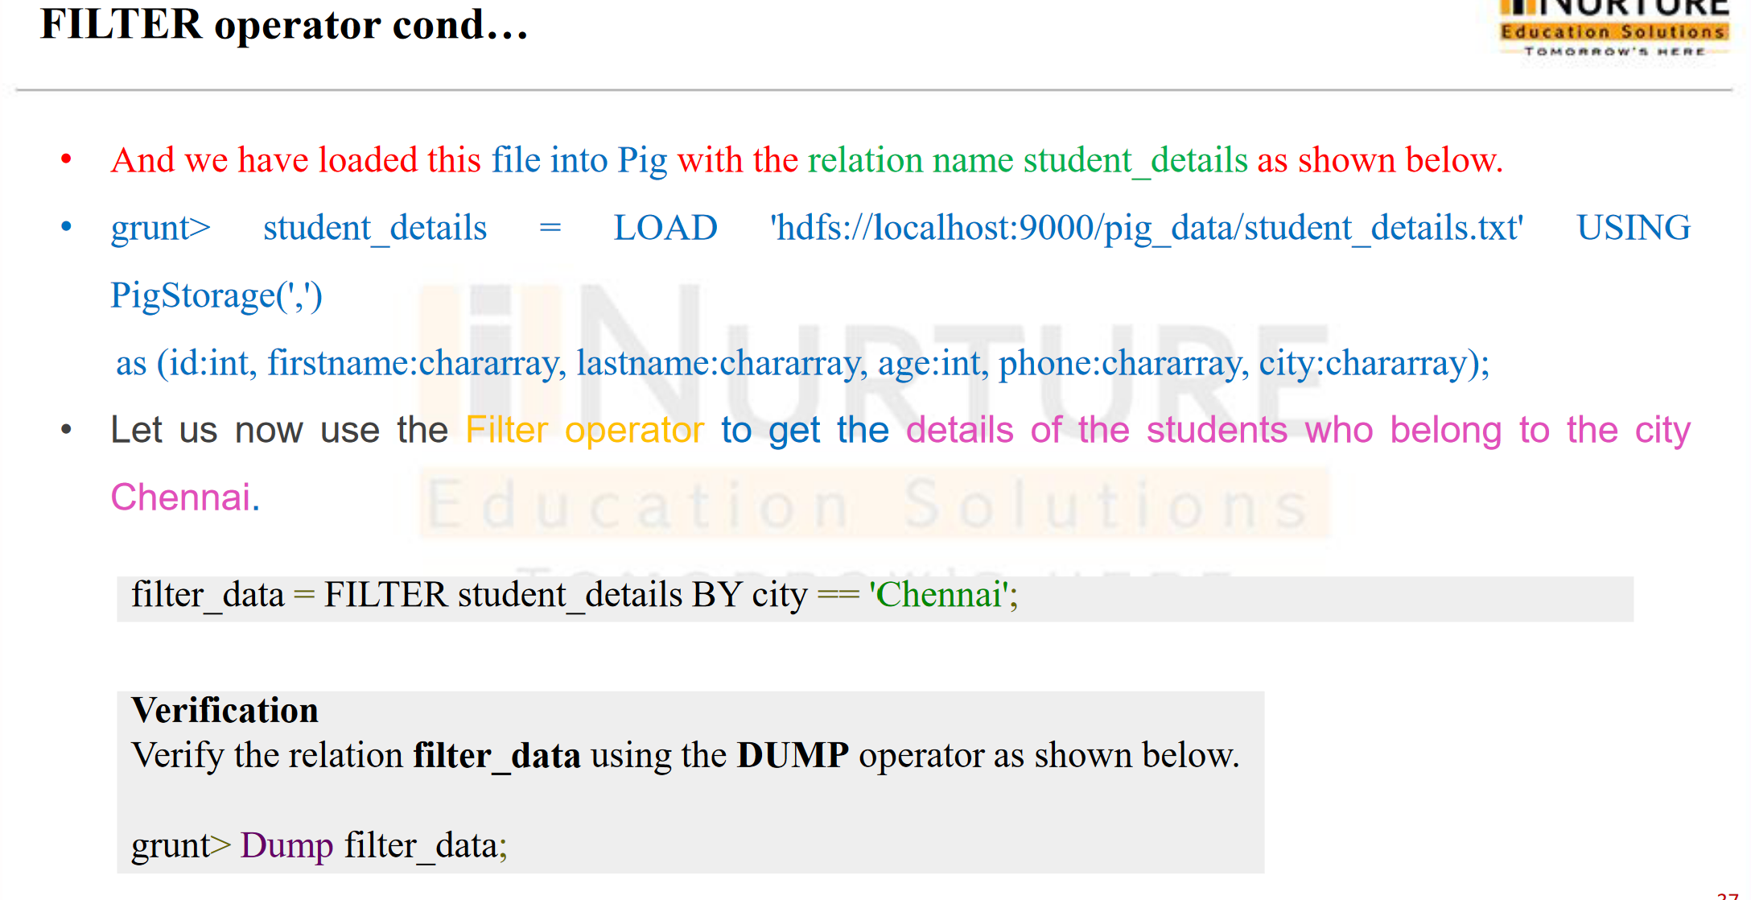

Slide 27
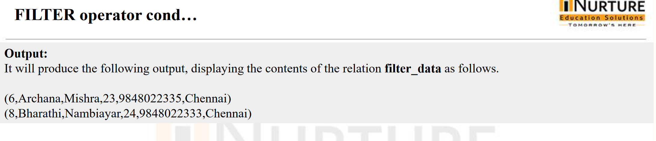

Slide 28
Join Operator
The JOIN operator is used to combine records from two or more relations. While performing a join operation, we declare one (or a group of) field(s) from each relation, as keys. When these keys match, the two particular tuples are matched, else the records are dropped. Joins can be of the following types −
Self-join
Inner-join
Outer-join − left join, right join, and full join

Slide 29
Join Operator
customers.txt
1,Ramesh,32,Ahmedabad,2000.00
2,Khilan,25,Delhi,1500.00
3,kaushik,23,Kota,2000.00
4,Chaitali,25,Mumbai,6500.00
5,Hardik,27,Bhopal,8500.00
6,Komal,22,MP,4500.00
7,Muffy,24,Indore,10000.00
orders.txt
102,2009-10-08 00:00:00,3,3000
100,2009-10-08 00:00:00,3,1500
101,2009-11-20 00:00:00,2,1560
103,2008-05-20 00:00:00,4,2060

Slide 30
Join Operator
And we have loaded these two files into Pig with the relations customers and orders as shown below.
grunt> customers = LOAD 'hdfs://localhost:9000/pig_data/customers.txt' USING PigStorage(',') as (id:int, name:chararray, age:int, address:chararray, salary:int); grunt> orders = LOAD 'hdfs://localhost:9000/pig_data/orders.txt' USING PigStorage(',') as (oid:int, date:chararray, customer_id:int, amount:int);

Slide 31
Join Operator
Self – join
Self-join is used to join a table with itself as if the table were two relations, temporarily renaming at least one relation.
grunt> customers1 = LOAD 'hdfs://localhost:9000/pig_data/customers.txt' USING PigStorage(',') as (id:int, name:chararray, age:int, address:chararray, salary:int);
grunt> customers2 = LOAD 'hdfs://localhost:9000/pig_data/customers.txt' USING PigStorage(',') as (id:int, name:chararray, age:int, address:chararray, salary:int);
Syntax
Given below is the syntax of performing self-join operation using the JOIN operator.
grunt> Relation3_name = JOIN Relation1_name BY key, Relation2_name BY key ;
Example
Let us perform self-join operation on the relation customers, by joining the two relations customers1 and customers2 as shown below.
grunt> customers3 = JOIN customers1 BY id, customers2 BY id;
grunt> Dump customers3;

Slide 32
Self – join
Self – join
Output
It will produce the following output, displaying the contents of the relation customers.
(1,Ramesh,32,Ahmedabad,2000,1,Ramesh,32,Ahmedabad,2000)
(2,Khilan,25,Delhi,1500,2,Khilan,25,Delhi,1500)
(3,kaushik,23,Kota,2000,3,kaushik,23,Kota,2000)
(4,Chaitali,25,Mumbai,6500,4,Chaitali,25,Mumbai,6500)
(5,Hardik,27,Bhopal,8500,5,Hardik,27,Bhopal,8500)
(6,Komal,22,MP,4500,6,Komal,22,MP,4500)
(7,Muffy,24,Indore,10000,7,Muffy,24,Indore,10000)

Slide 33
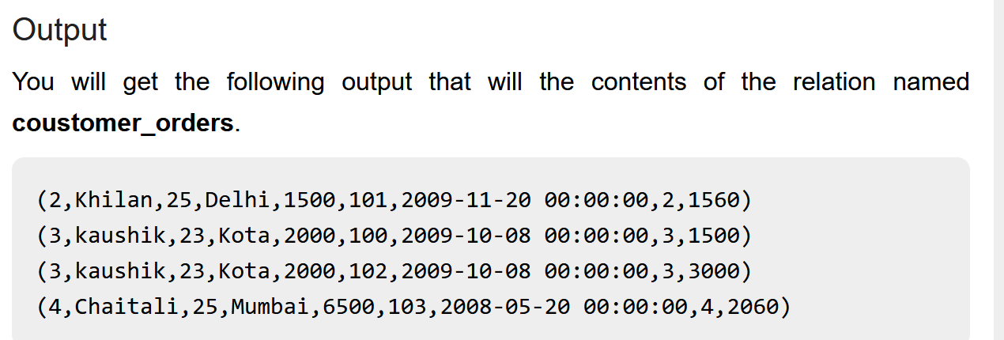
Inner Join
Inner Join
Inner Join is used quite frequently; it is also referred to as equijoin. An inner join returns rows when there is a match in both tables.
Here is the syntax of performing inner join operation using the JOIN operator.
grunt> result = JOIN relation1 BY columnname, relation2 BY columnname;
Example
Let us perform inner join operation on the two relations customers and orders as shown below.
grunt> coustomer_orders = JOIN customers BY id, orders BY customer_id;
grunt> Dump coustomer_orders;

Slide 34
Join Operator
Left Outer Join:
The left outer Join operation returns all rows from the left table, even if there are no matches in the right relation.
Syntax
grunt> Relation3_name = JOIN Relation1_name BY id LEFT OUTER, Relation2_name BY customer_id;
grunt> outer_left = JOIN customers BY id LEFT OUTER, orders BY customer_id;
grunt> Dump outer_left;
Output:
(1,Ramesh,32,Ahmedabad,2000,,,,)
(2,Khilan,25,Delhi,1500,101,2009-11-20 00:00:00,2,1560)
(3,kaushik,23,Kota,2000,100,2009-10-08 00:00:00,3,1500)
(3,kaushik,23,Kota,2000,102,2009-10-08 00:00:00,3,3000)
(4,Chaitali,25,Mumbai,6500,103,2008-05-20 00:00:00,4,2060)
(5,Hardik,27,Bhopal,8500,,,,)
(6,Komal,22,MP,4500,,,,)
(7,Muffy,24,Indore,10000,,,,)

Slide 35
Right Outer Join
Right Outer Join:
The right outer join operation returns all rows from the right table, even if there are no matches in the left table.
Syntax
grunt> outer_right = JOIN customers BY id RIGHT, orders BY customer_id;
grunt> outer_right = JOIN customers BY id RIGHT, orders BY customer_id;
grunt> Dump outer_right;
Output:
(2,Khilan,25,Delhi,1500,101,2009-11-20 00:00:00,2,1560)
(3,kaushik,23,Kota,2000,100,2009-10-08 00:00:00,3,1500)
(3,kaushik,23,Kota,2000,102,2009-10-08 00:00:00,3,3000)
(4,Chaitali,25,Mumbai,6500,103,2008-05-20 00:00:00,4,2060)

Slide 36
Full Outer Join
Full Outer Join:
The full outer join operation returns rows when there is a match in one of the relations.
Syntax
grunt> outer_full = JOIN customers BY id FULL OUTER, orders BY customer_id;
grunt> outer_full = JOIN customers BY id FULL OUTER, orders BY customer_id;
grunt> Dump outer_full;
Output:
(1,Ramesh,32,Ahmedabad,2000,,,,)
(2,Khilan,25,Delhi,1500,101,2009-11-20 00:00:00,2,1560)
(3,kaushik,23,Kota,2000,100,2009-10-08 00:00:00,3,1500)
(3,kaushik,23,Kota,2000,102,2009-10-08 00:00:00,3,3000)
(4,Chaitali,25,Mumbai,6500,103,2008-05-20 00:00:00,4,2060)
(5,Hardik,27,Bhopal,8500,,,,)
(6,Komal,22,MP,4500,,,,)
(7,Muffy,24,Indore,10000,,,,)

Slide 37
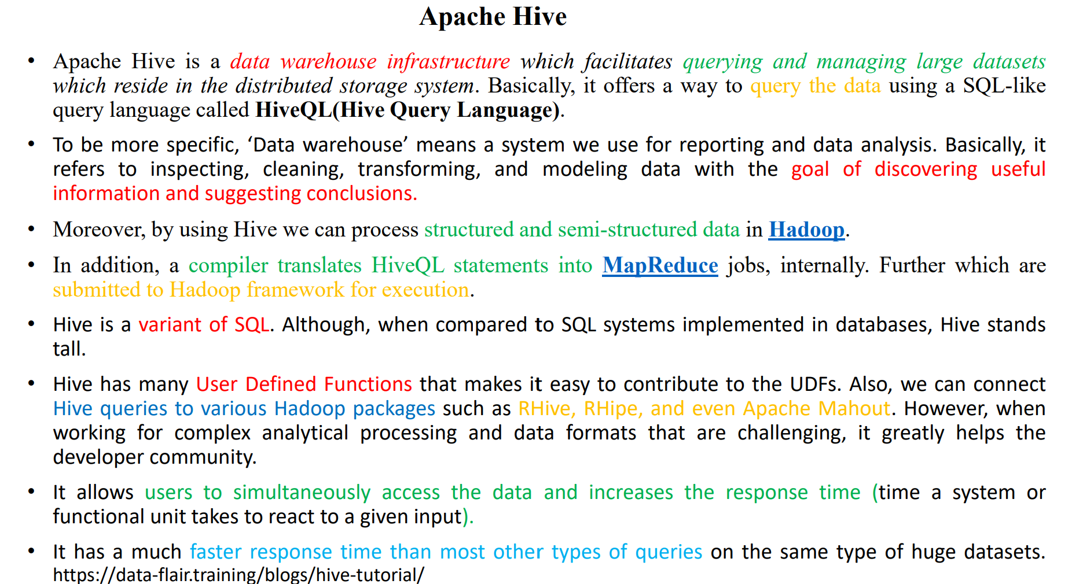

Slide 38
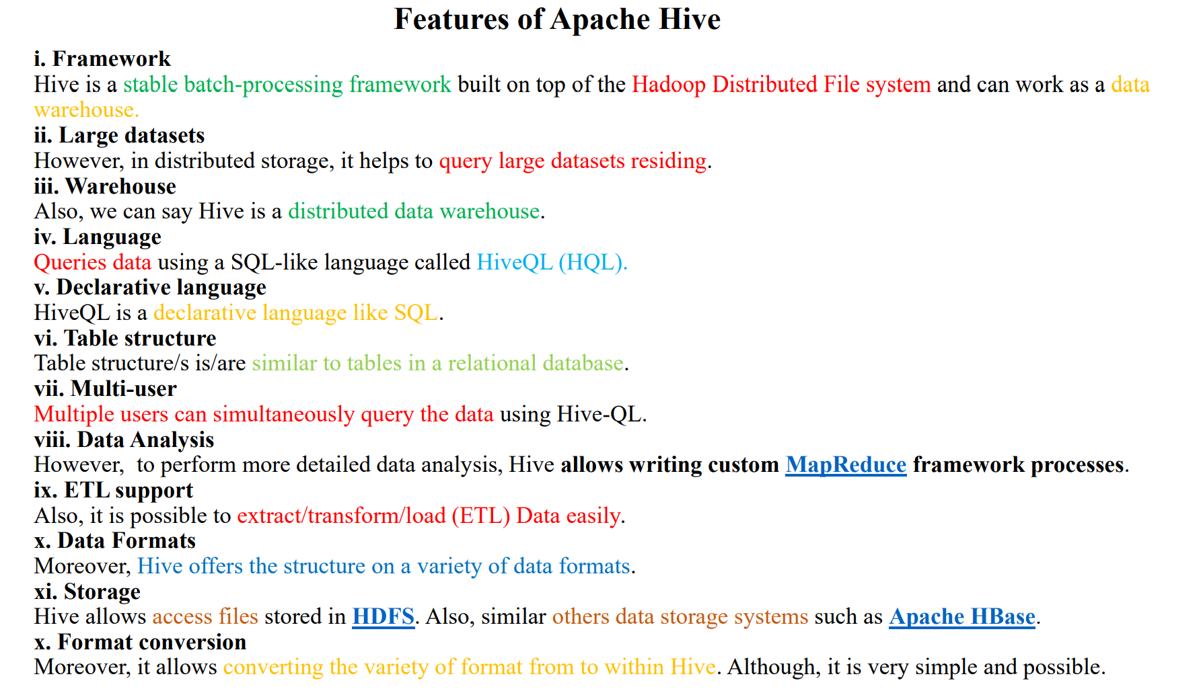

Slide 39
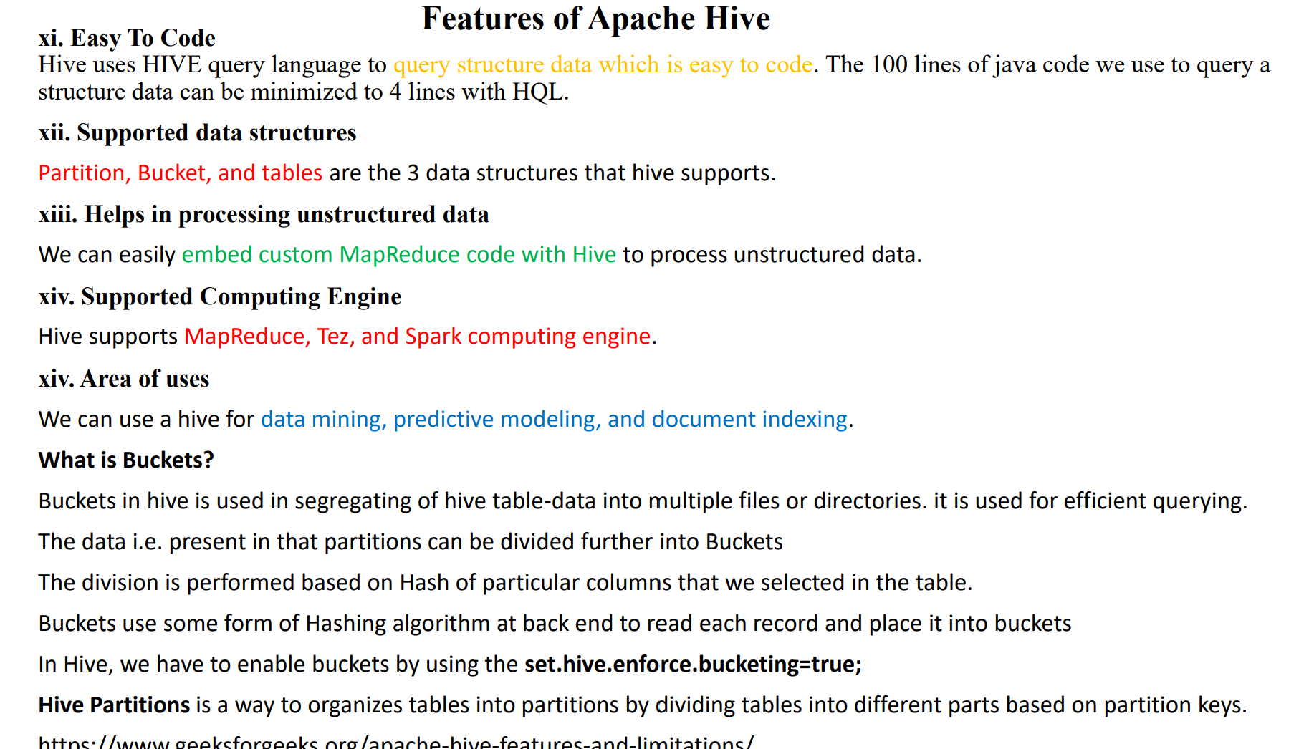

Slide 40
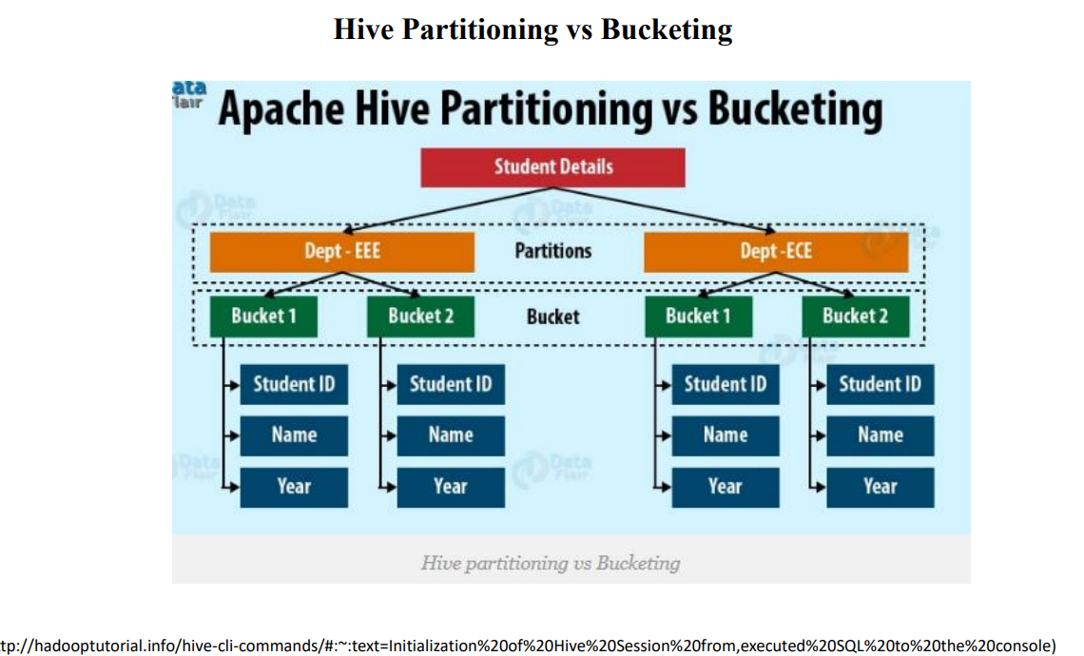

Slide 41
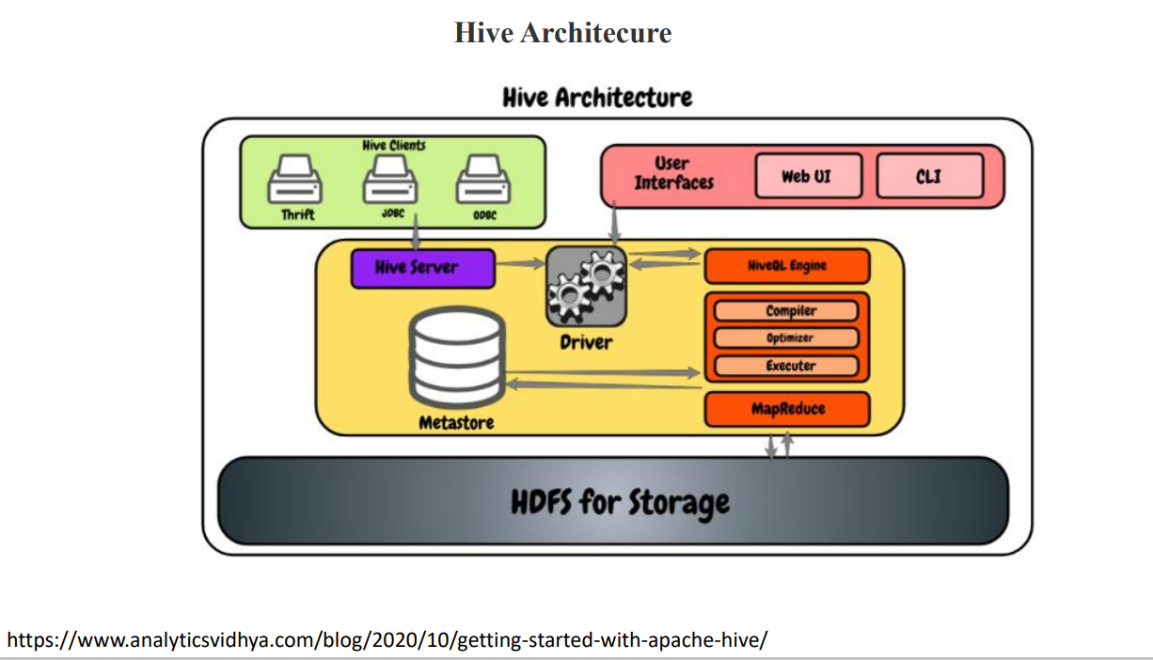
Notes:
JDBC Driver is a software component that enables java application to interact with the database. There are 4 types of JDBC drivers:JDBC-ODBC bridge driver
Native-API driver (partially java driver)
Network Protocol driver (fully java driver)
Thin driver (fully java driver)
1) JDBC-ODBC bridge driver
The JDBC-ODBC bridge driver uses ODBC driver to connect to the database. The JDBC-ODBC bridge driver converts JDBC method calls into the ODBC function calls. This is now discouraged because of thin driver.

Slide 42
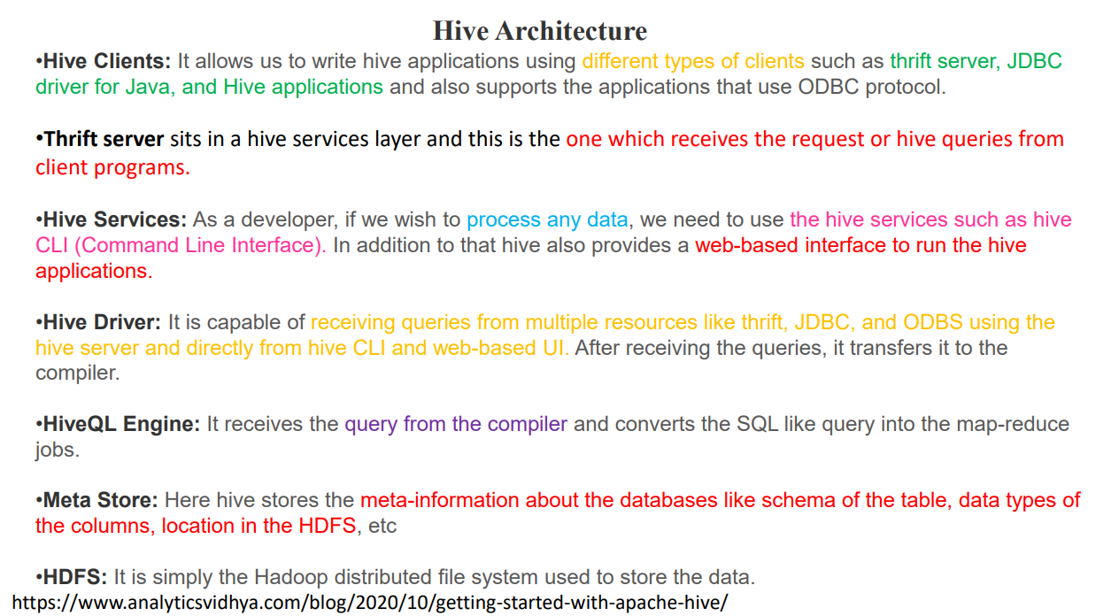

Slide 43
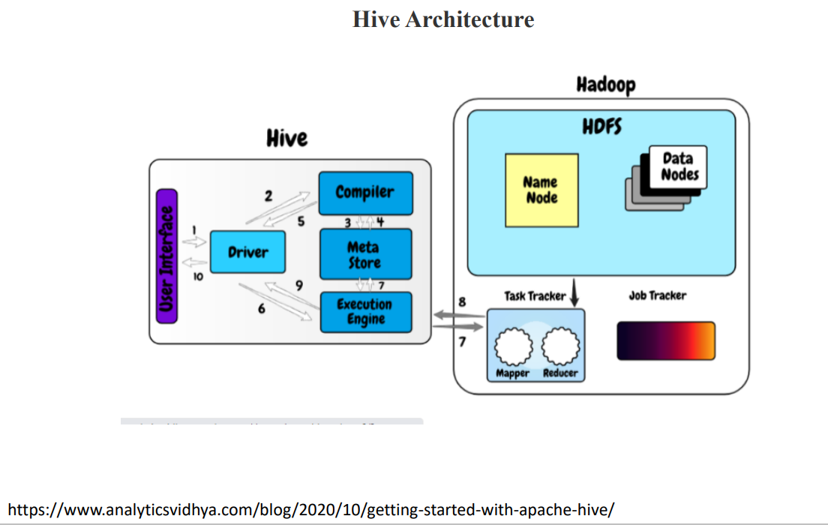

Slide 44
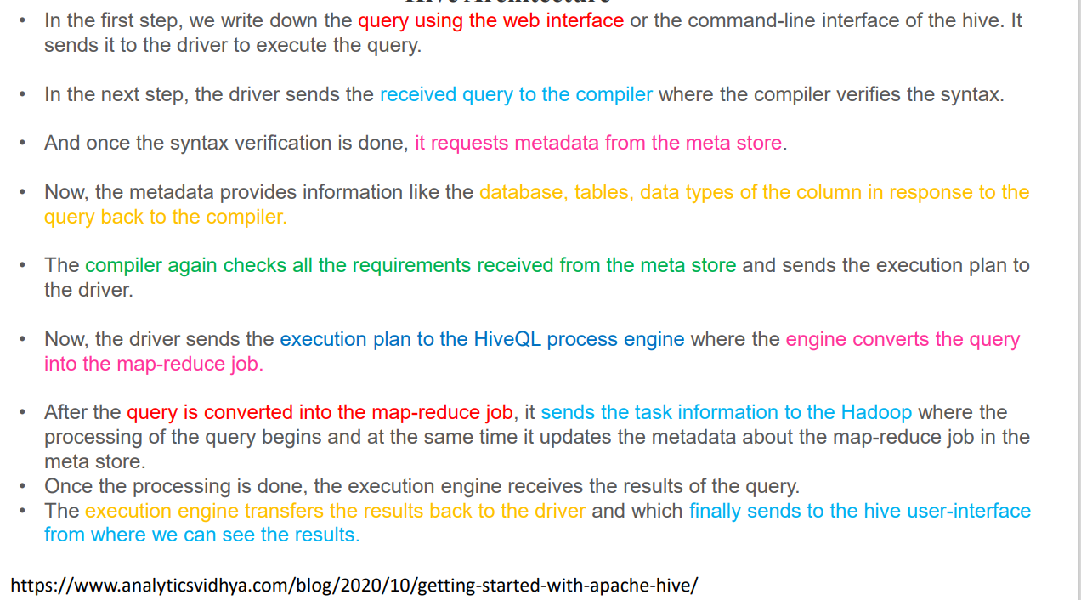
Hive Architecture

Slide 45
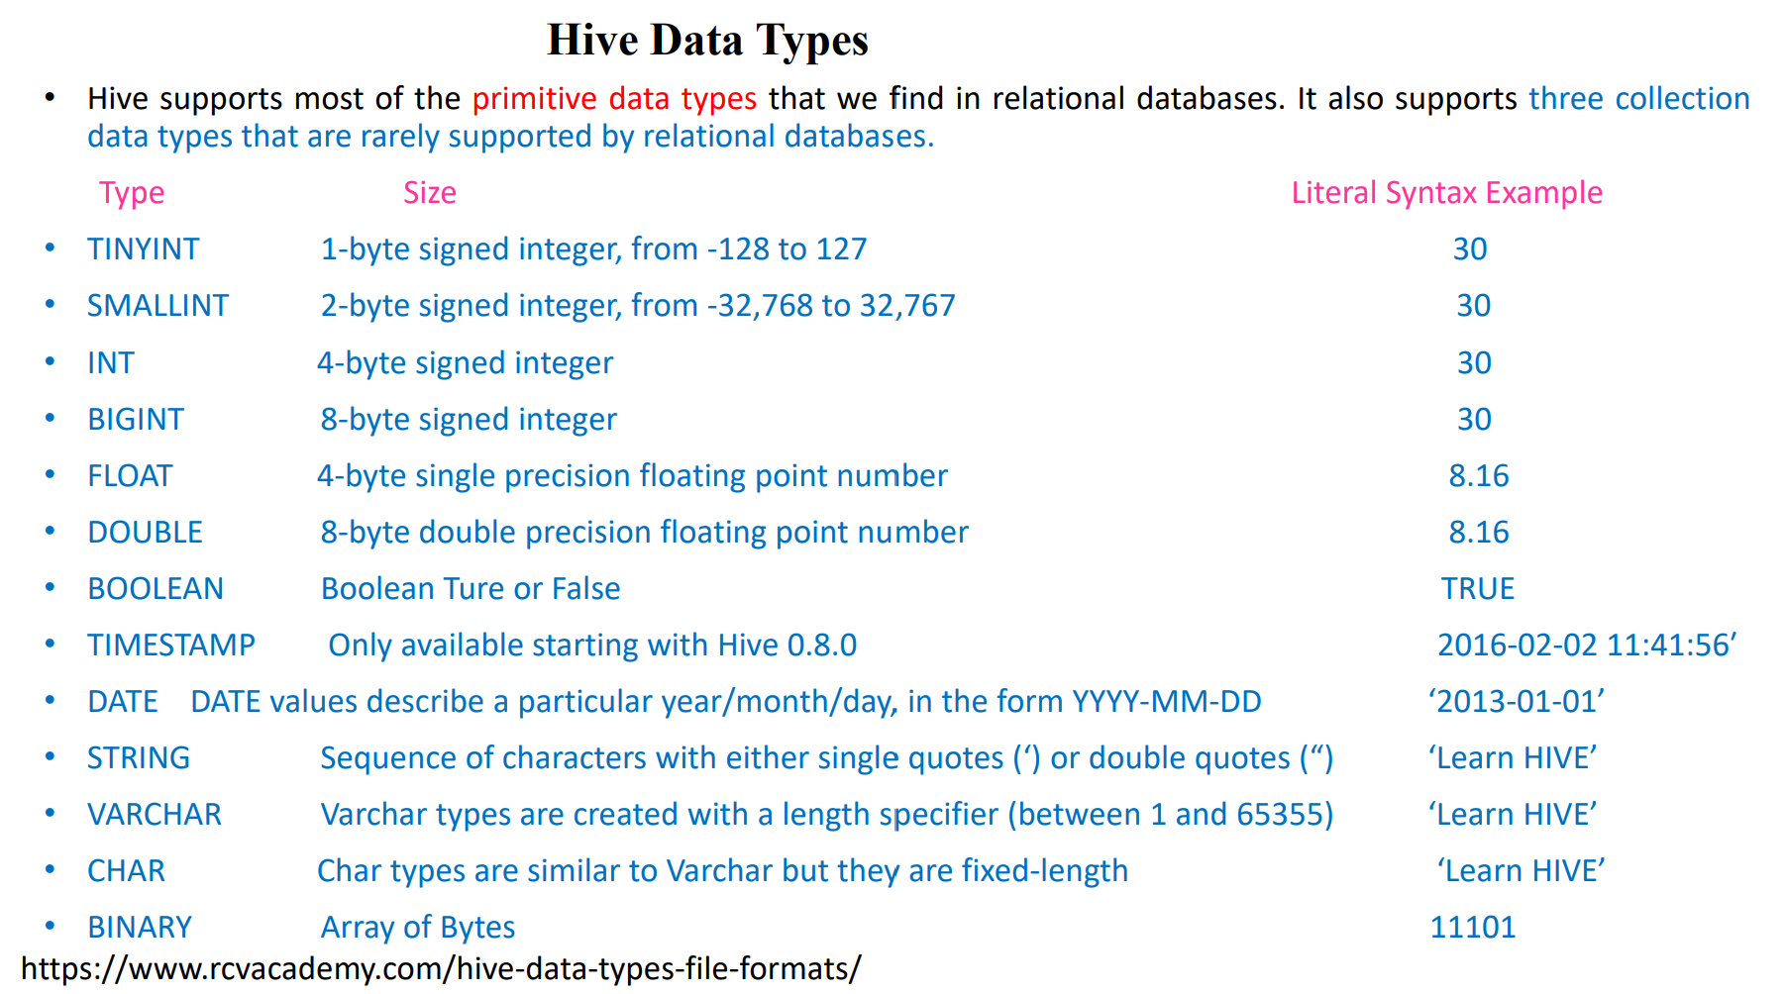

Slide 46
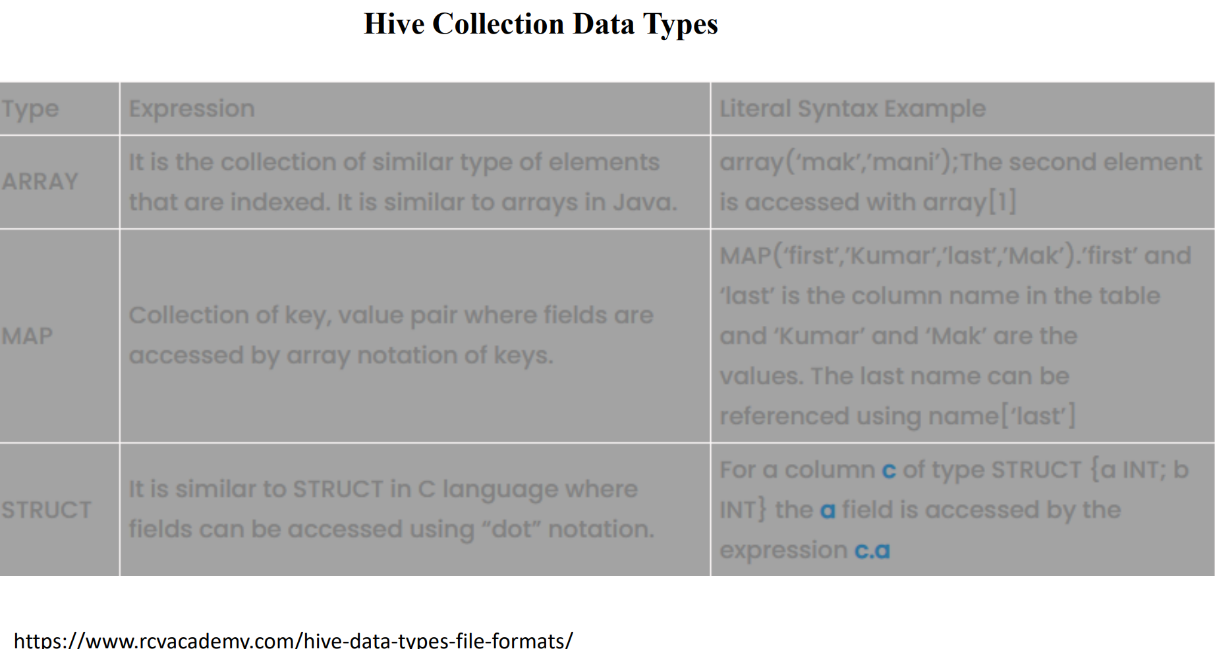

Slide 47
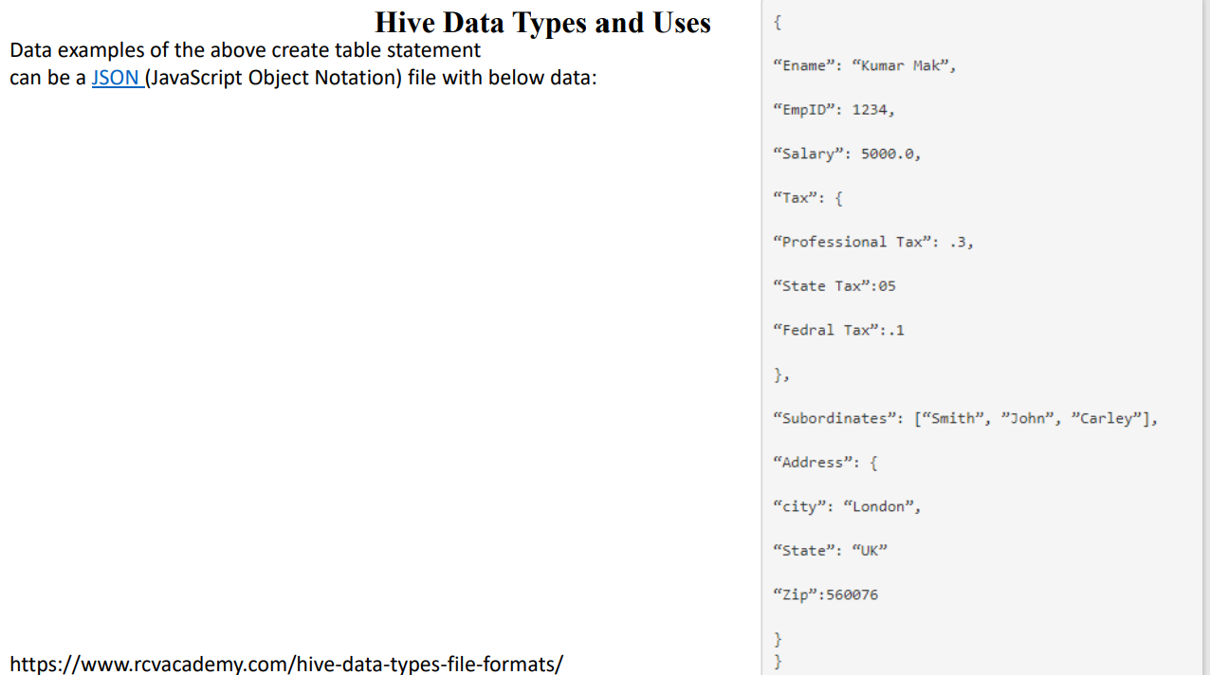

Slide 48
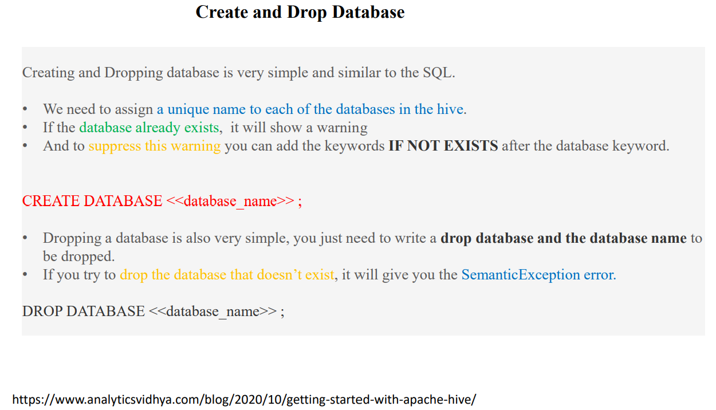

Slide 49
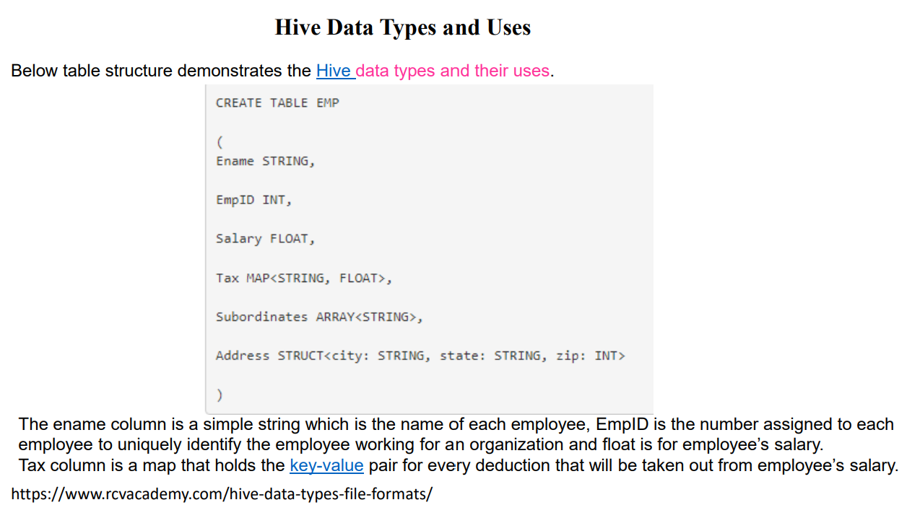

Slide 50
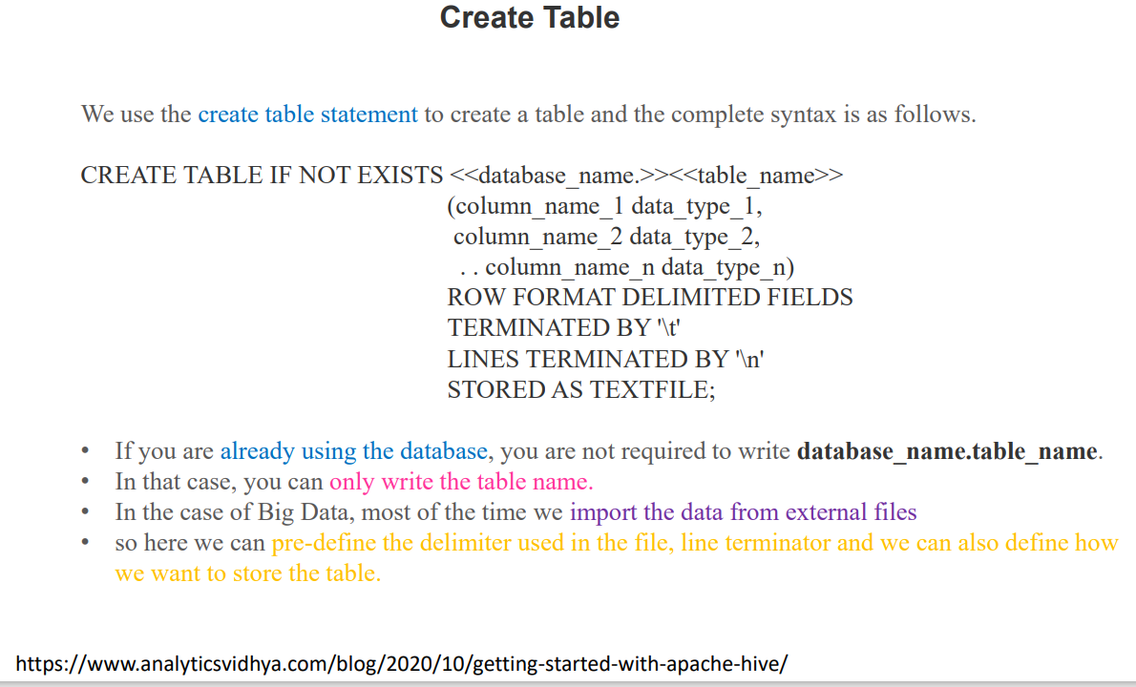

Slide 51
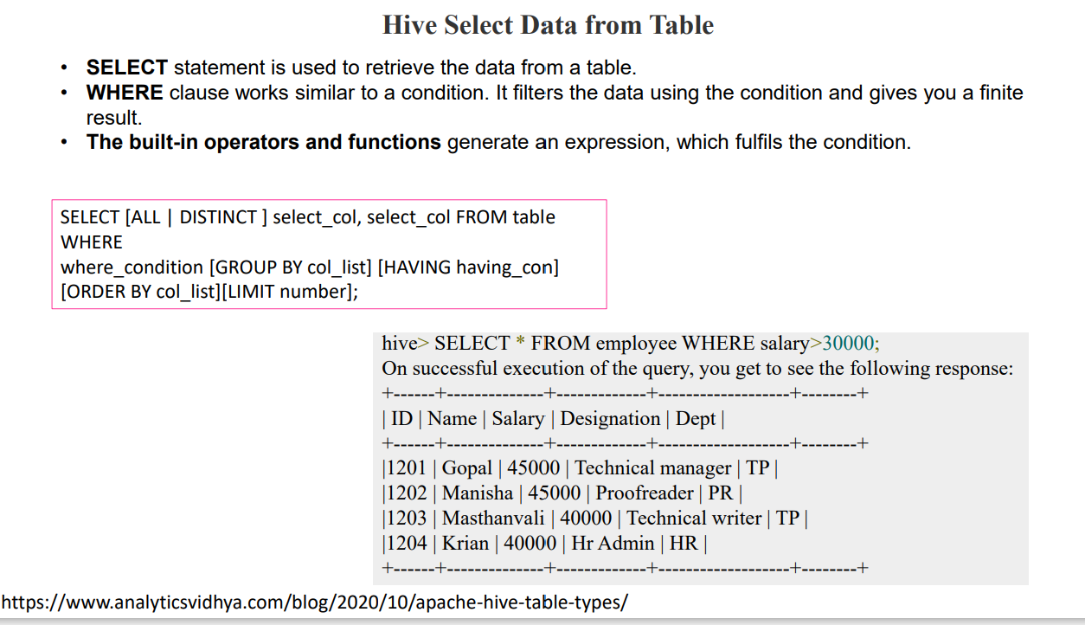

Slide 52
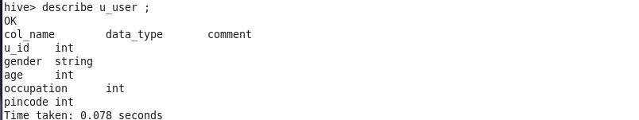
STEP 1: Create a u_user table.
STEP 2: SEE THE FIELD DESCRIPTIONS OF U_USER TABLE.

Slide 53
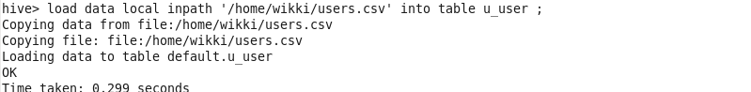
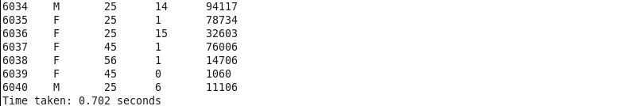
STEP 3: LOAD DATA INTO U_USER TABLE FROM A LOCAL TEXT FILE.
STEP 4: Show all the data in the newly created user table.

Slide 54
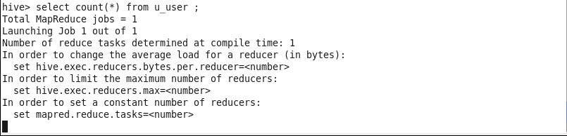
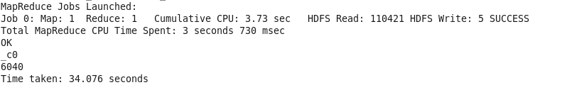
STEP 5: COUNT THE NUMBER OF DATA IN THE U_USER TABLE.

Slide 55
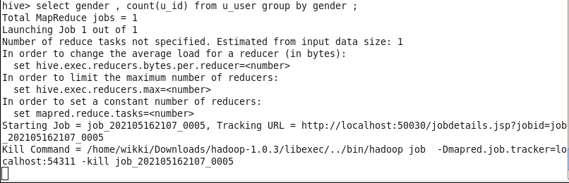
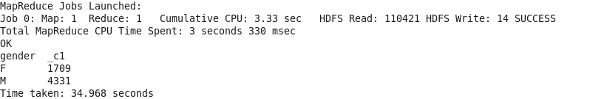
STEP 6: COUNT THE NUMBER OF USER IN THE U_USER TABLE GENDERWISE.

Slide 56
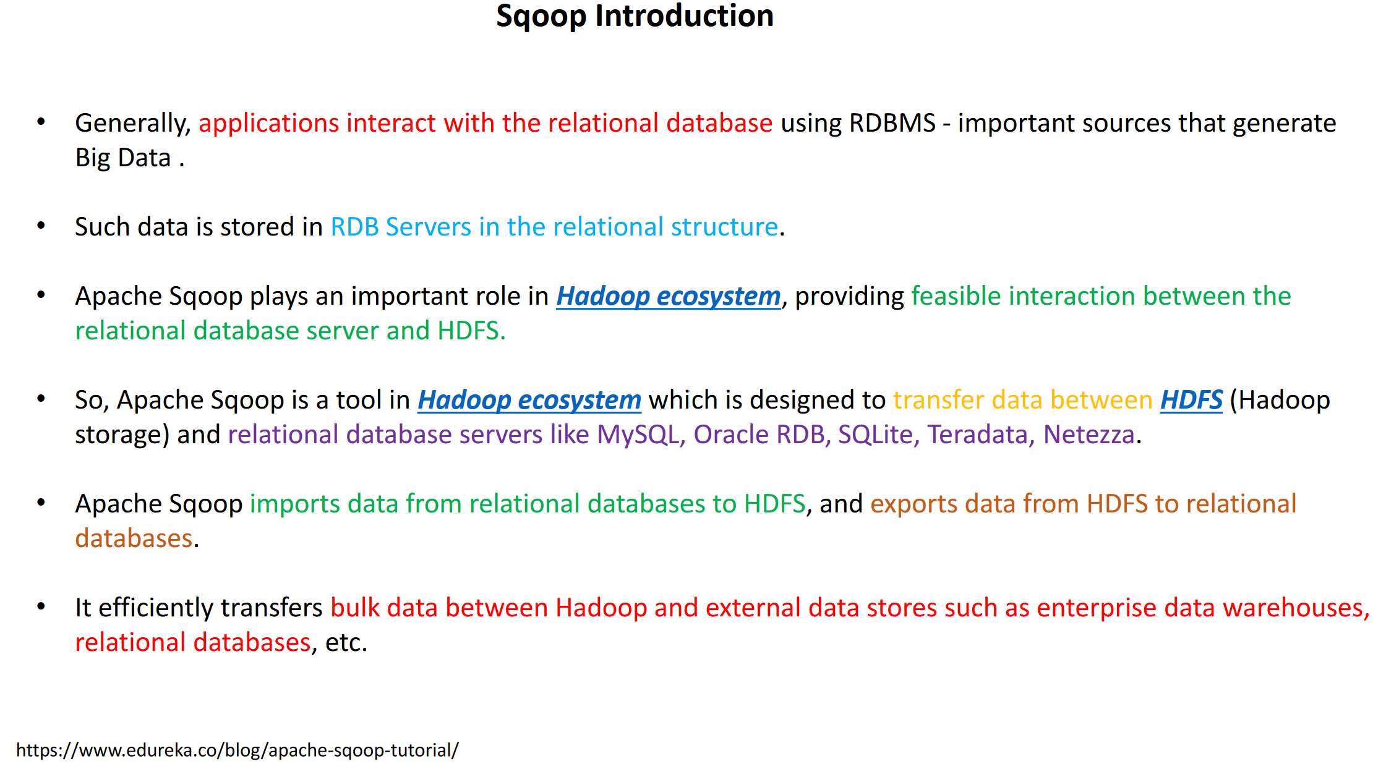

Slide 57
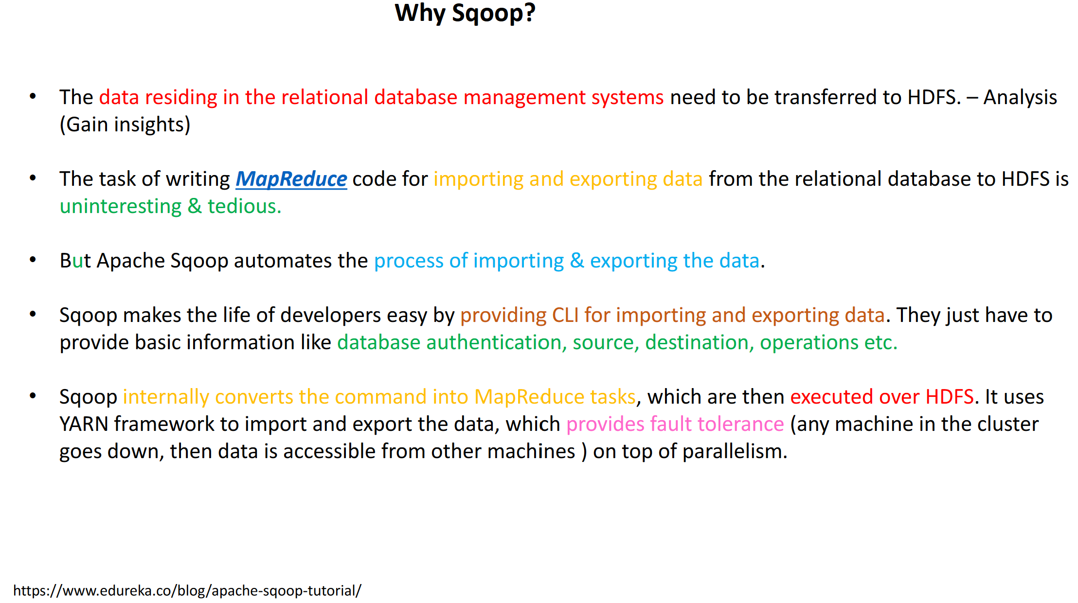

Slide 58
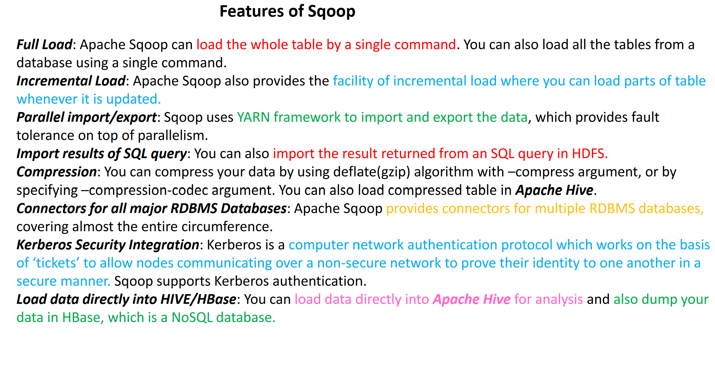

Slide 59


Slide 60


Slide 61


Slide 62


Slide 63


Slide 64


Slide 65


Slide 66


Slide 67


Slide 68


Slide 69


Slide 70


